Slide 1
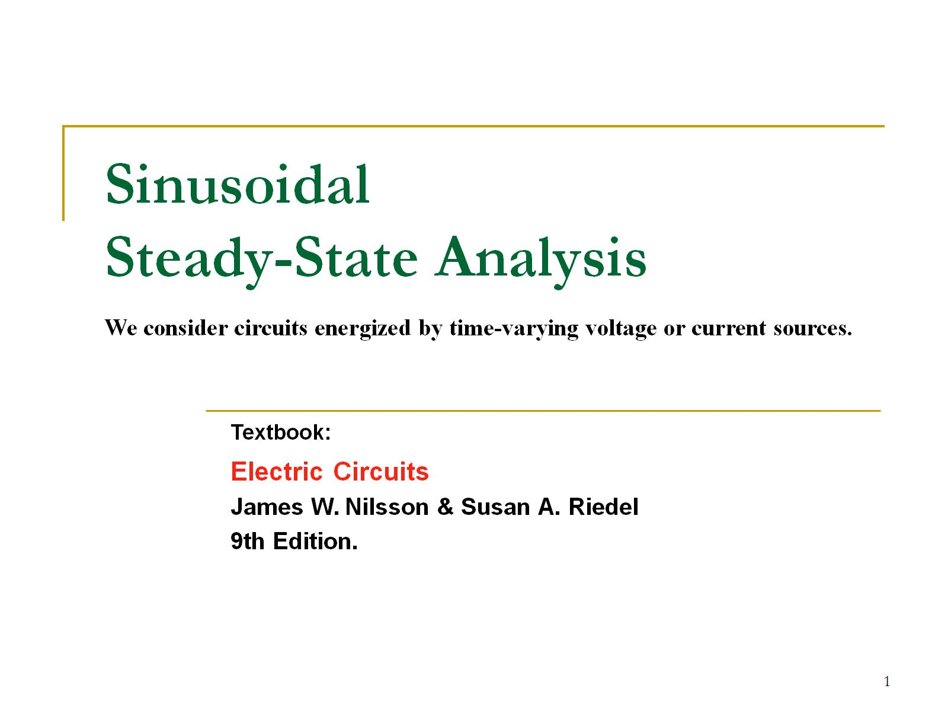
Sinusoidal Steady-State Analysis

Slide 2
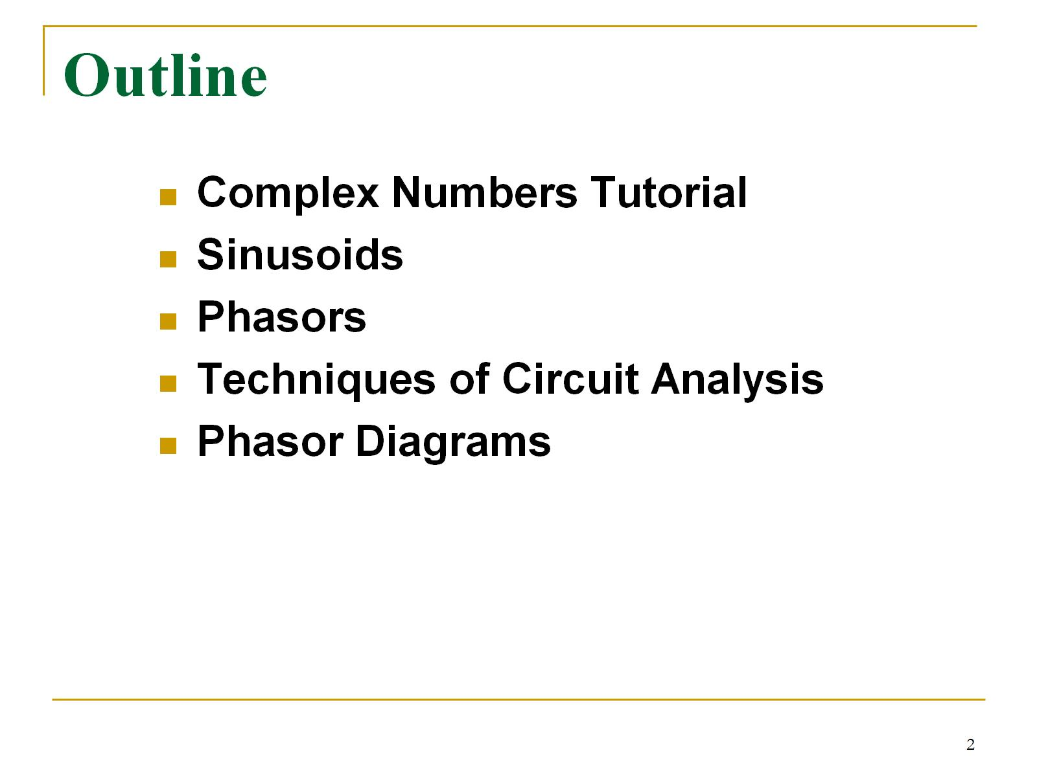
Outline

Slide 3
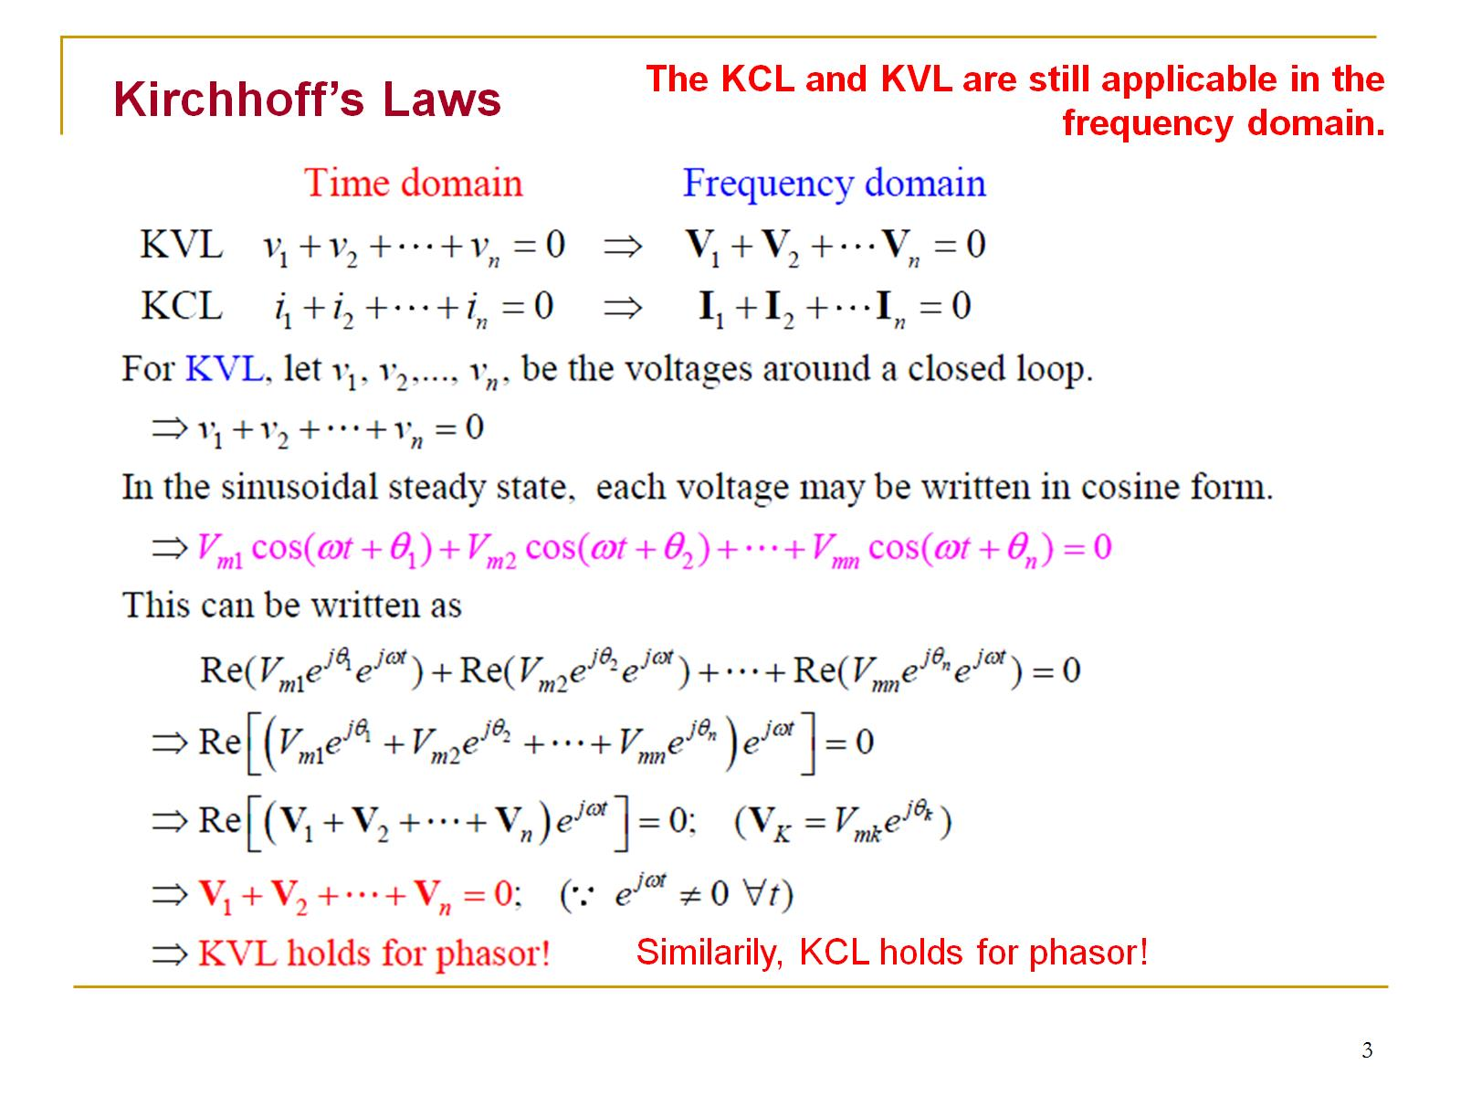

Slide 4
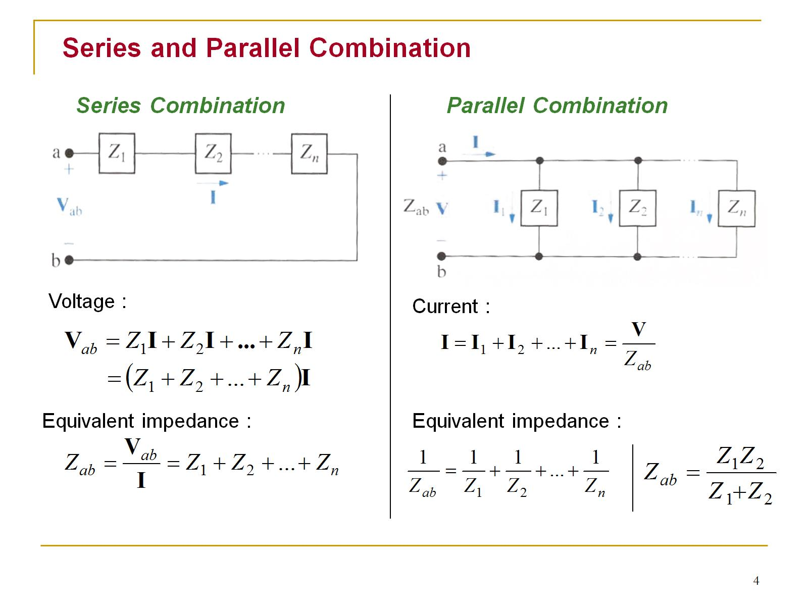

Slide 5
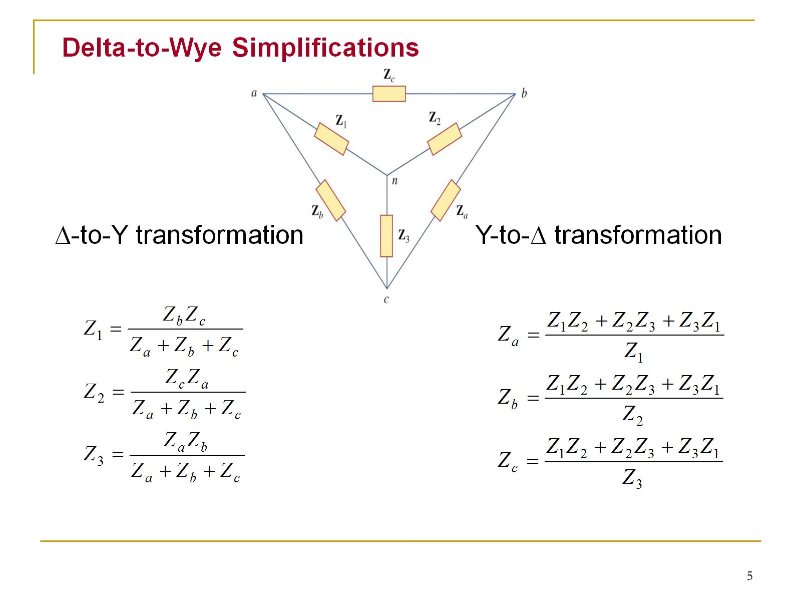

Slide 6
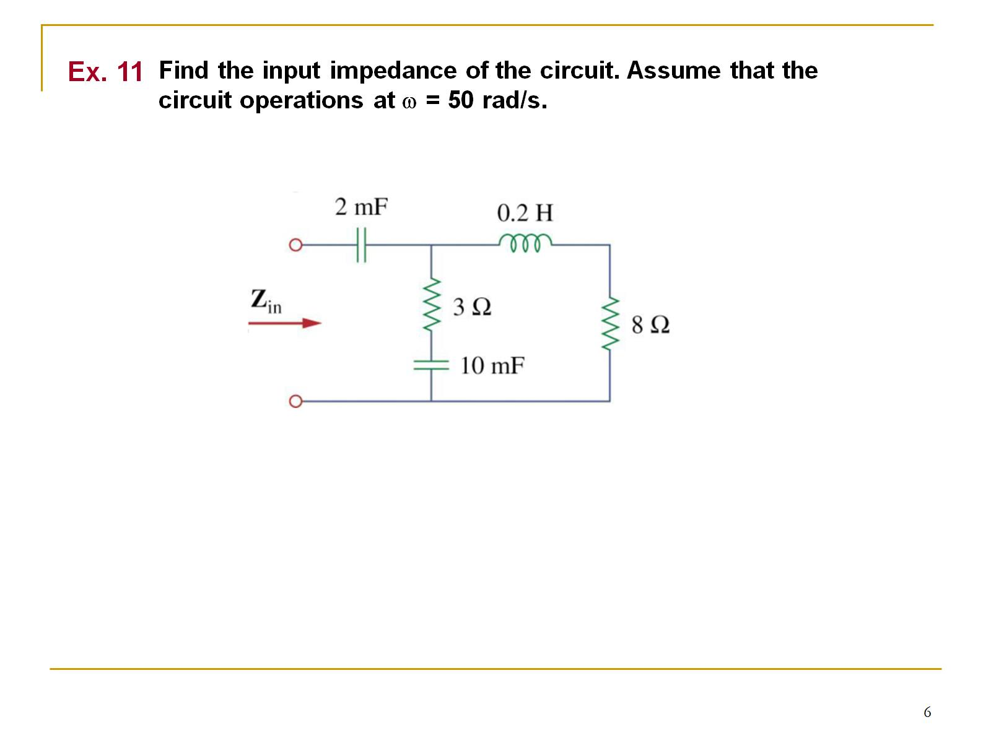

Slide 7
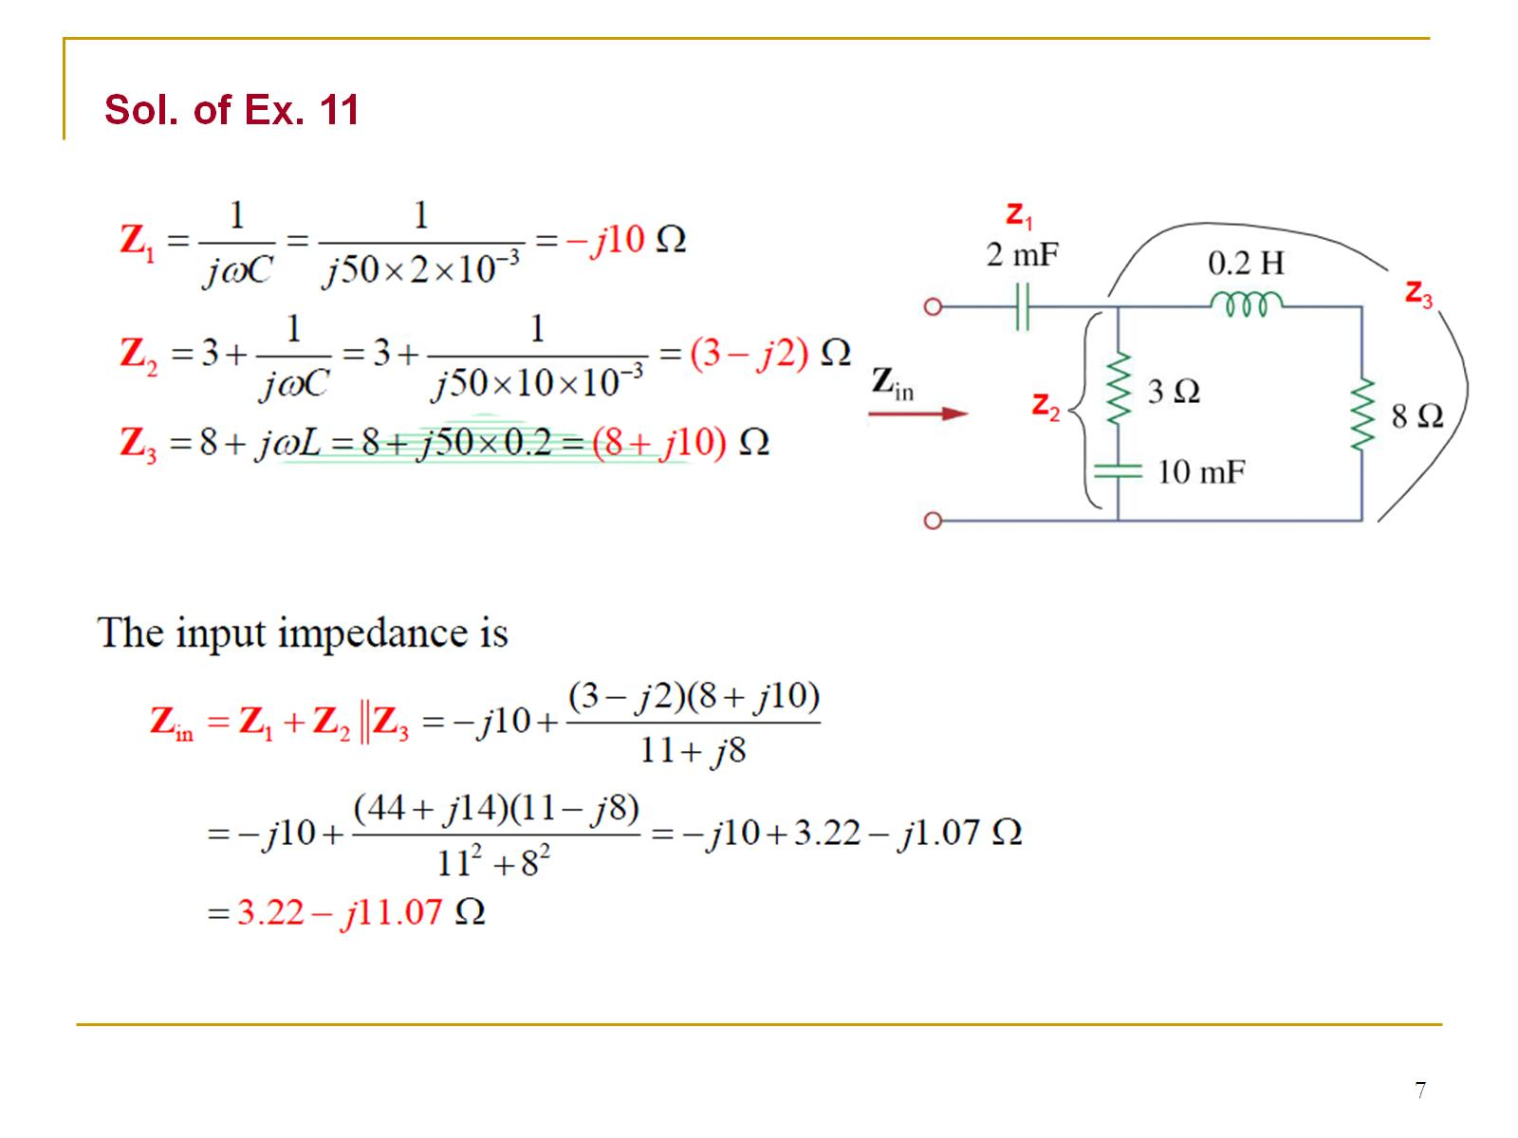

Slide 8
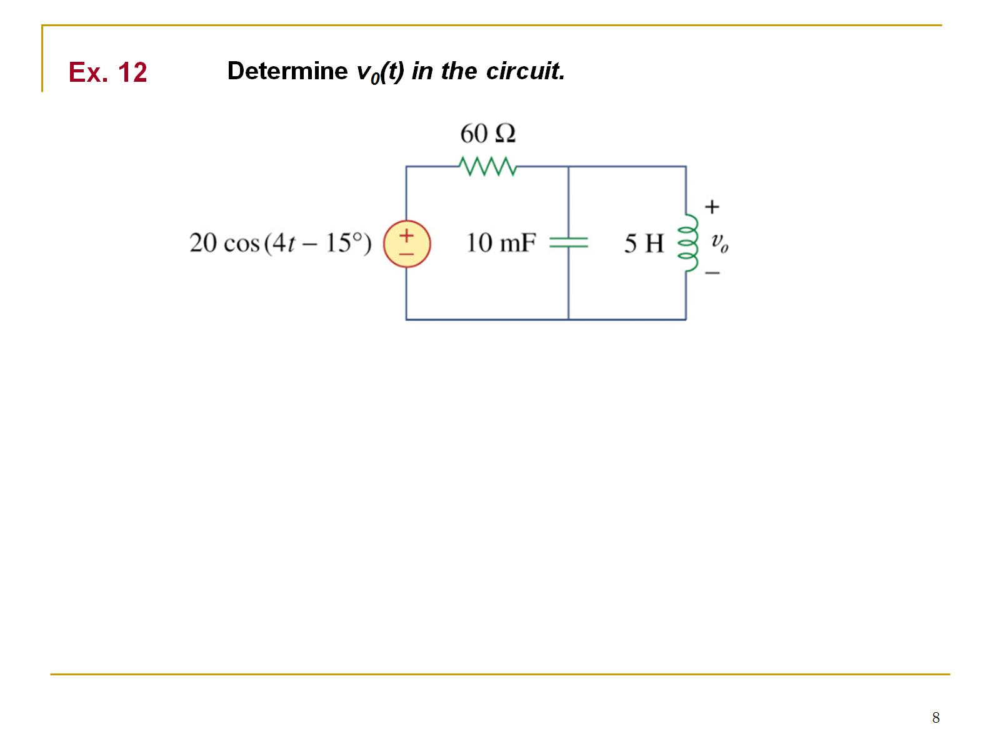

Slide 9
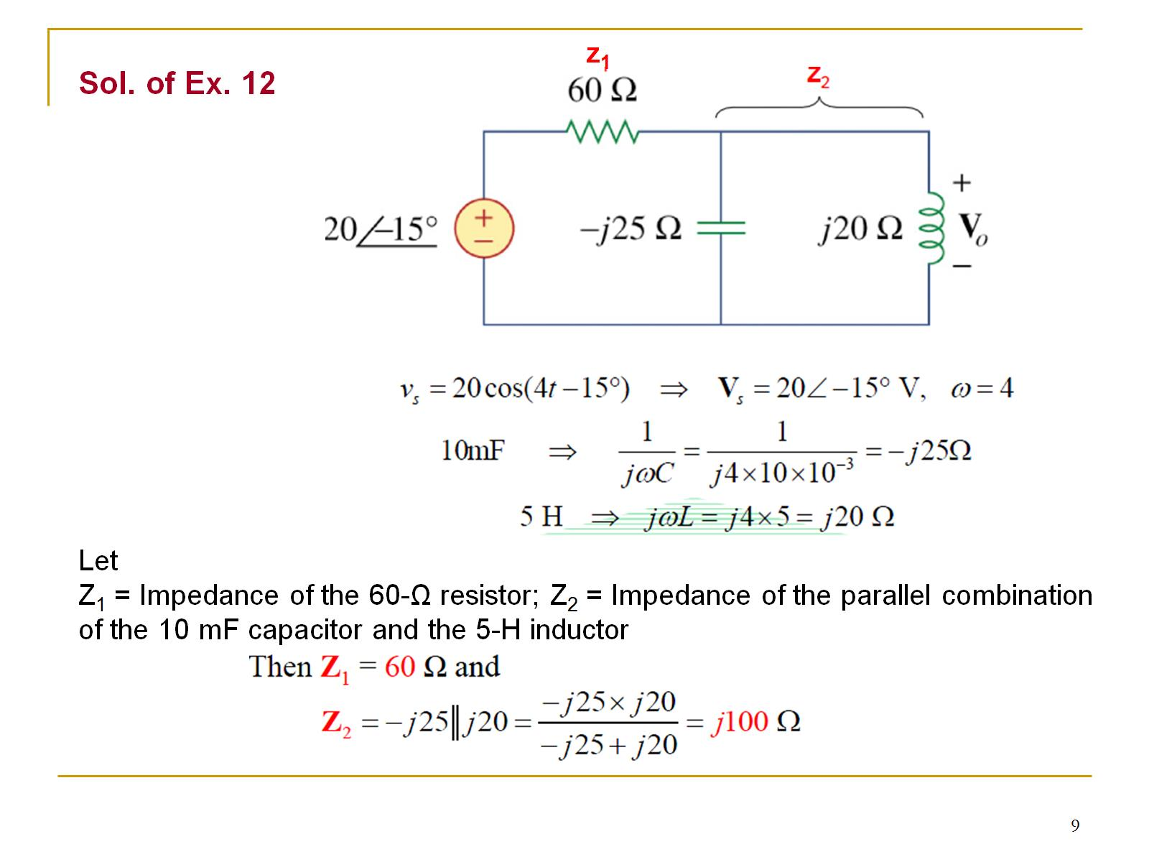

Slide 10
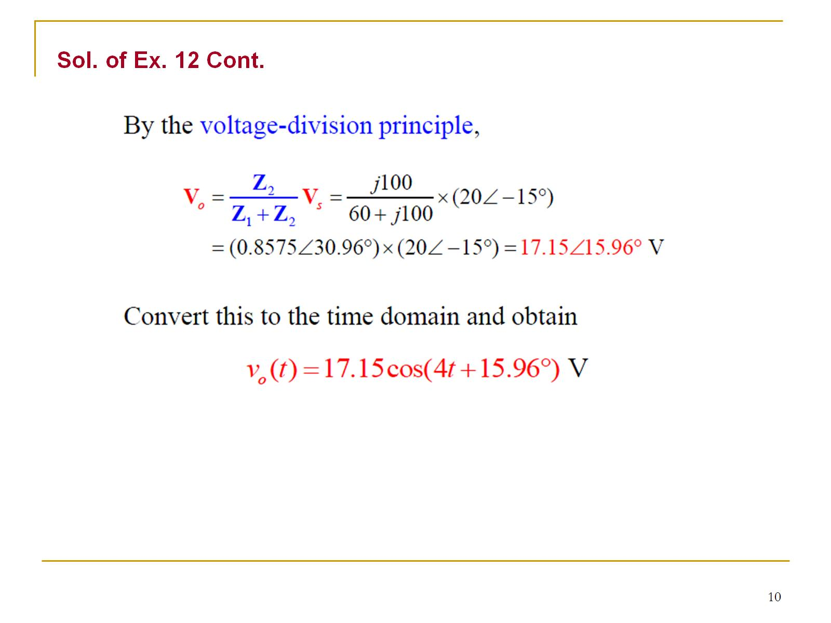

Slide 11
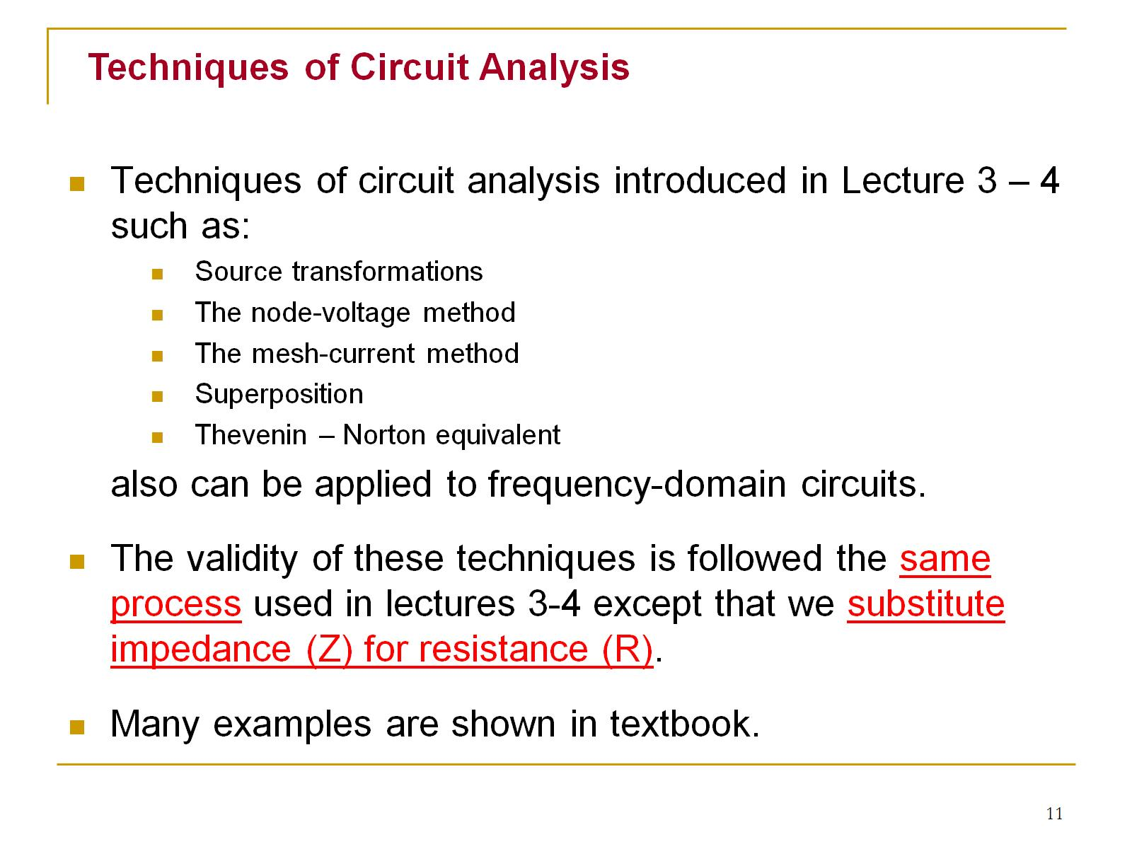

Slide 12
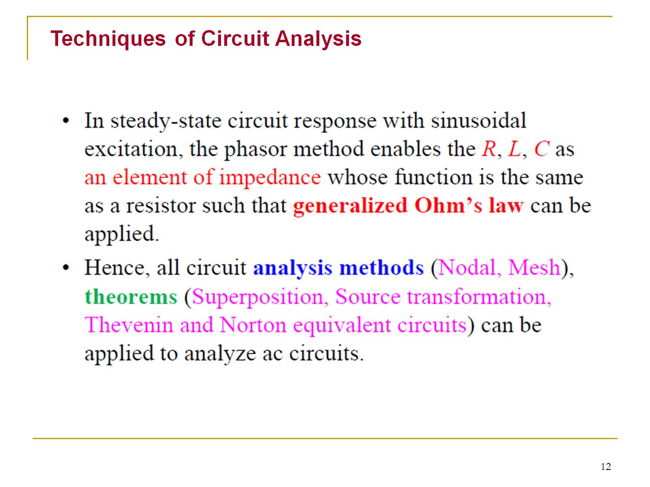

Slide 13
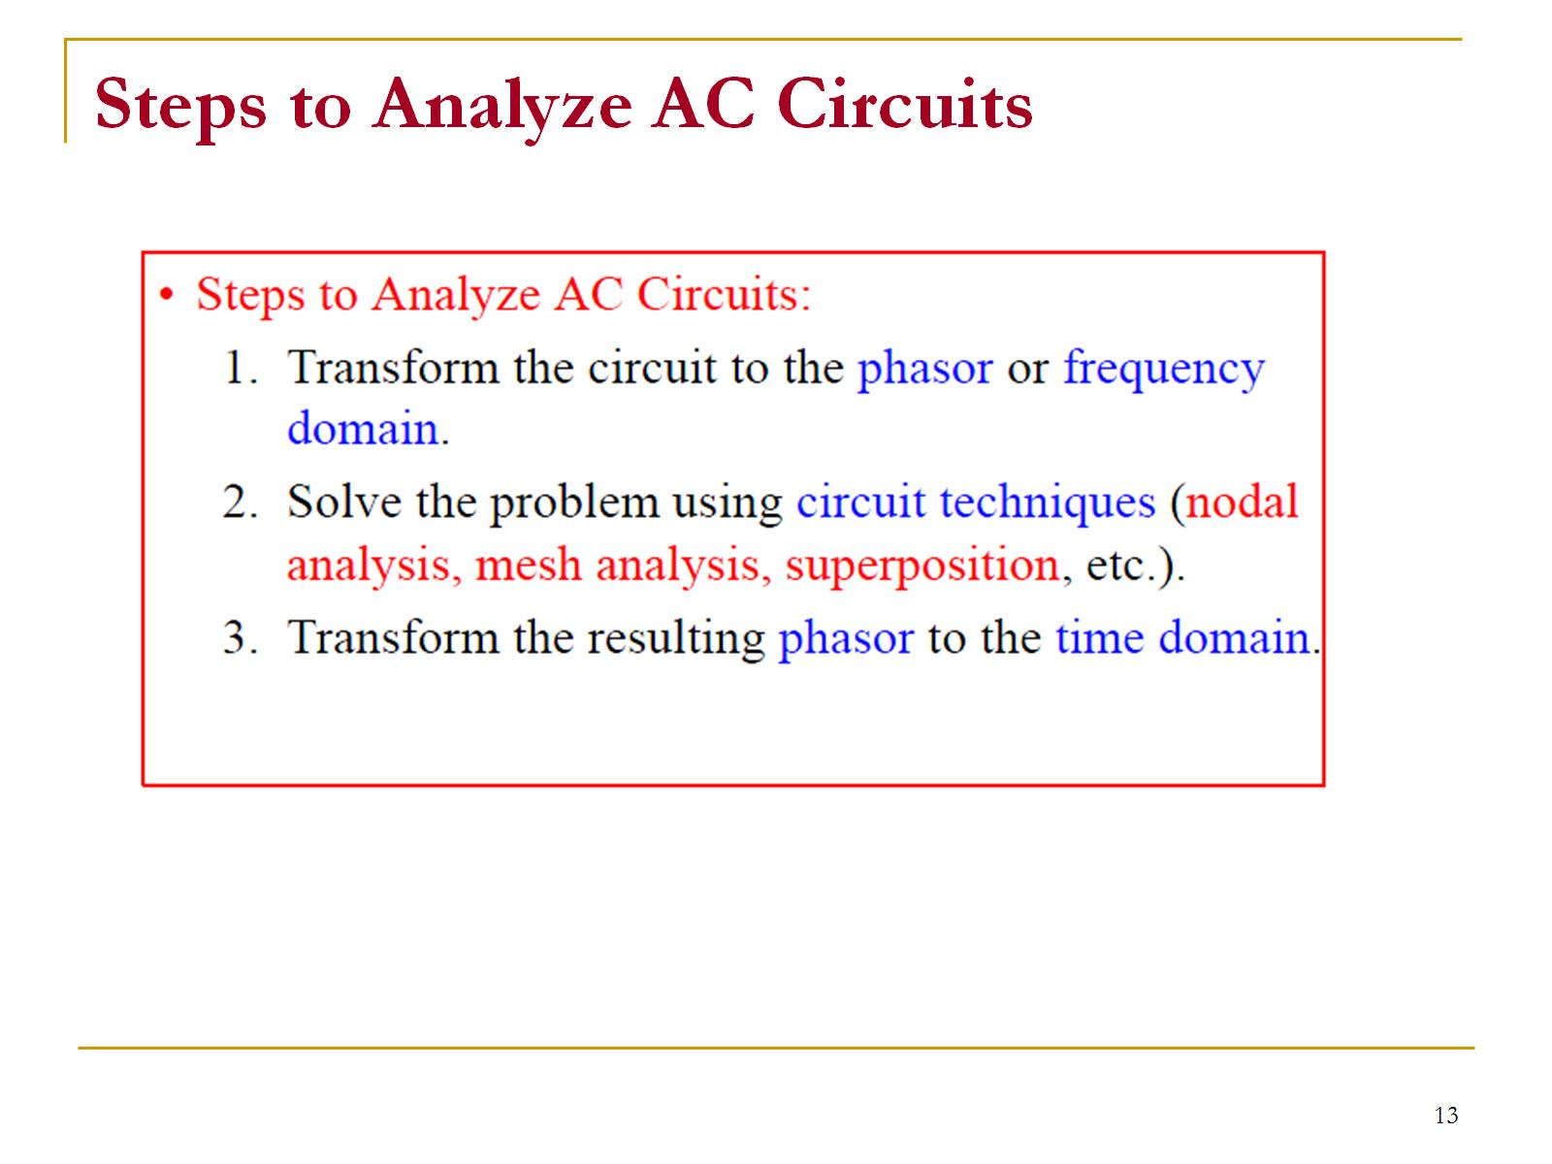
Steps to Analyze AC Circuits

Slide 14
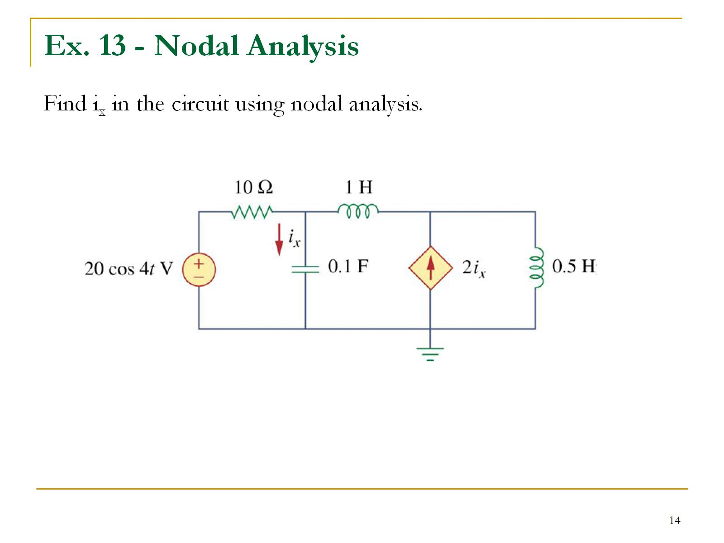
Ex. 13 - Nodal Analysis

Slide 15
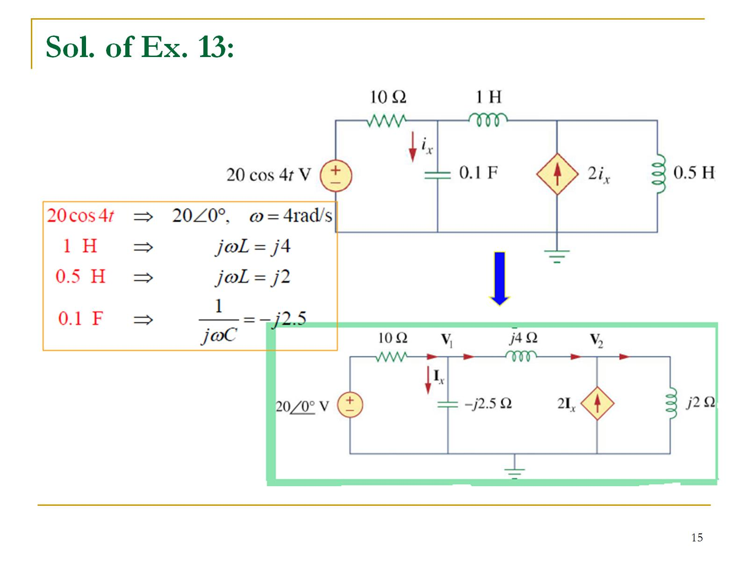
Sol. of Ex. 13:

Slide 16
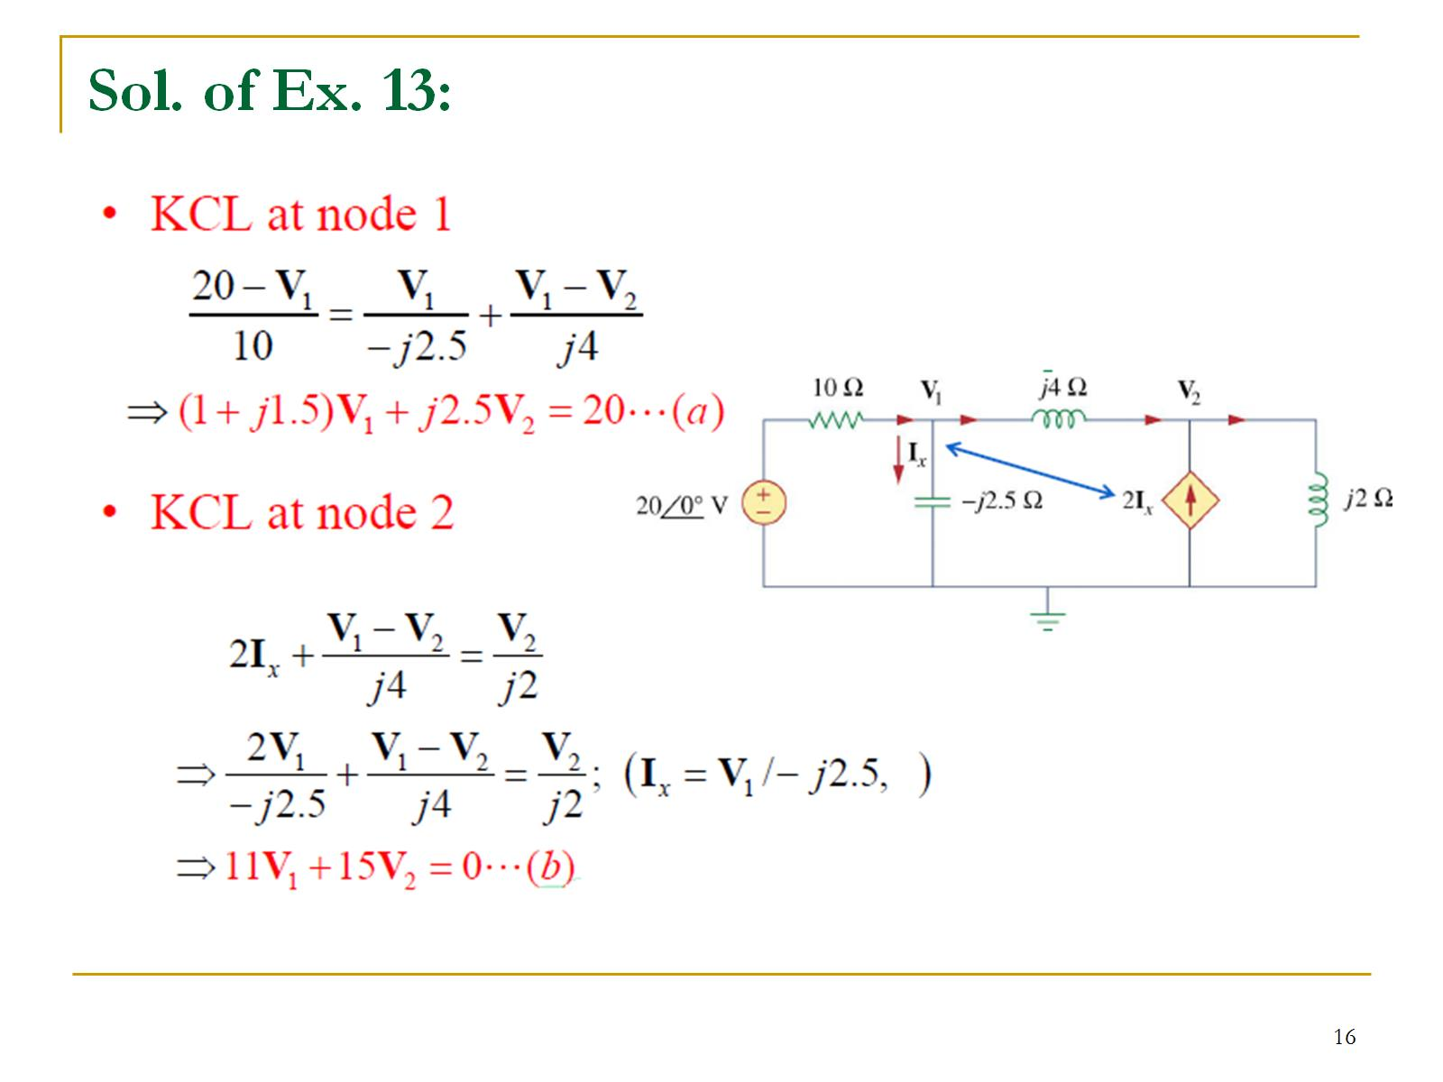
Sol. of Ex. 13:

Slide 17
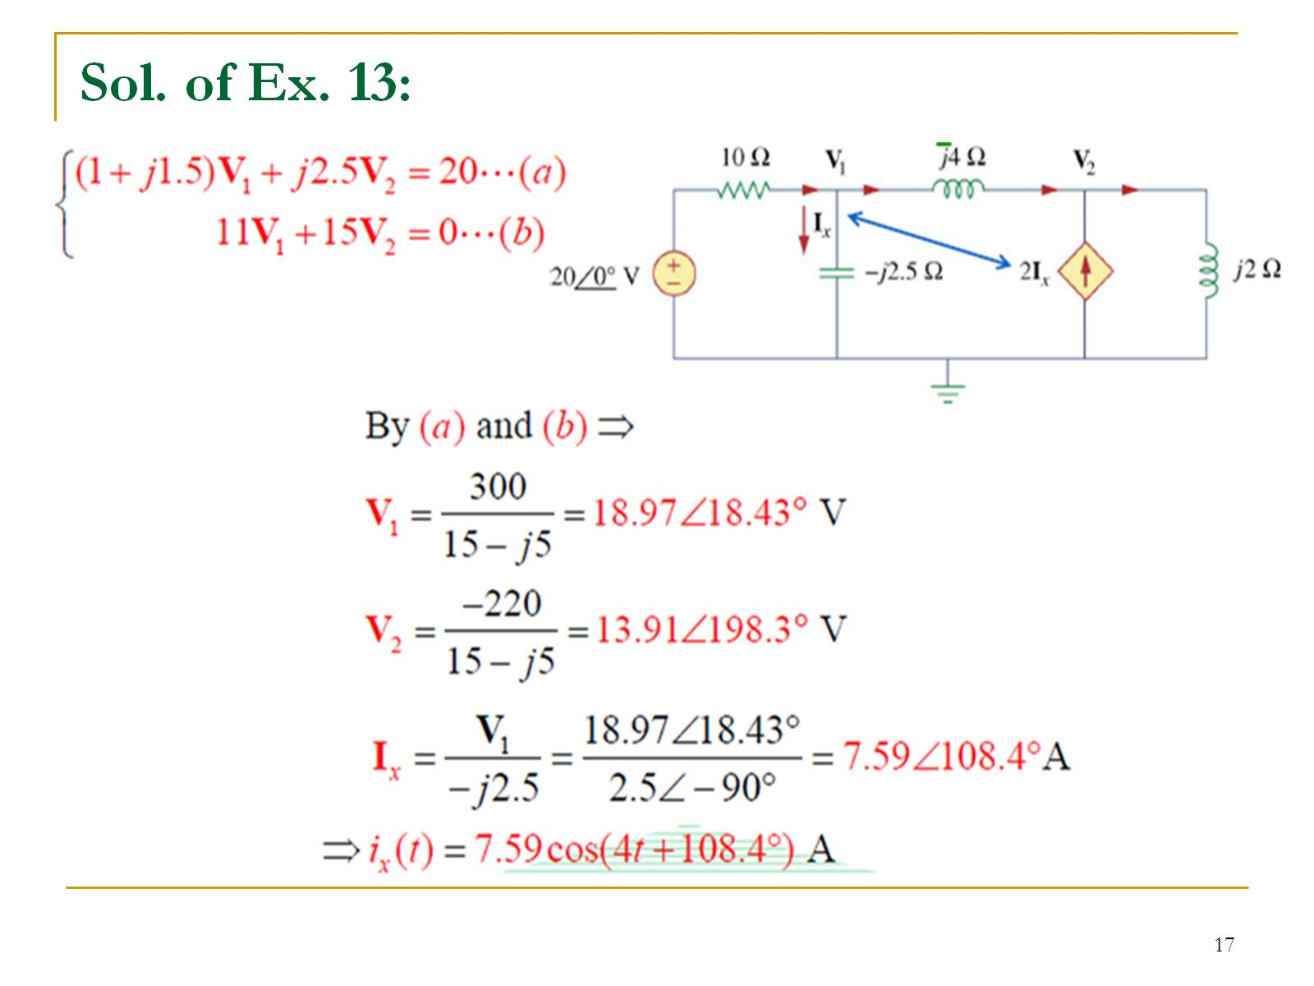
Sol. of Ex. 13:

Slide 18
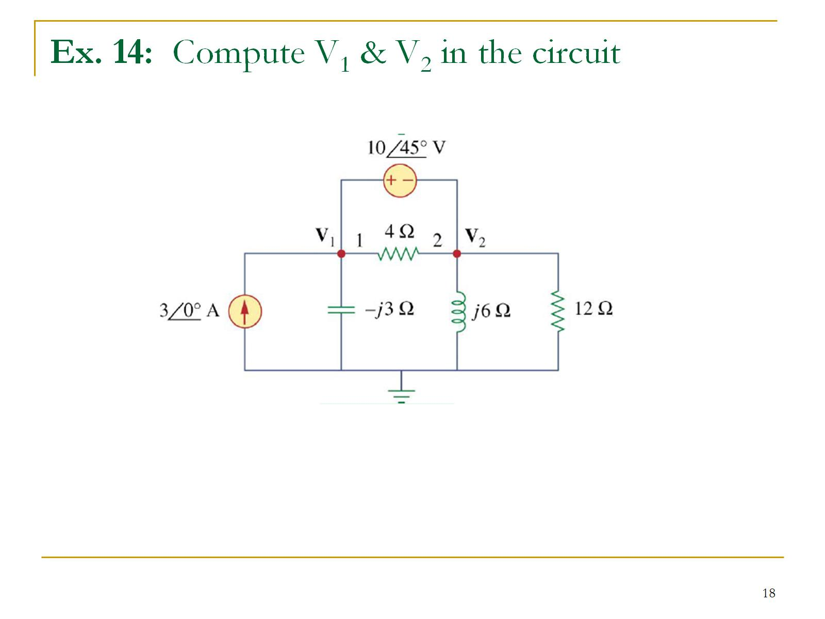
Ex. 14: Compute V₁ & V₂ in the circuit

Slide 19
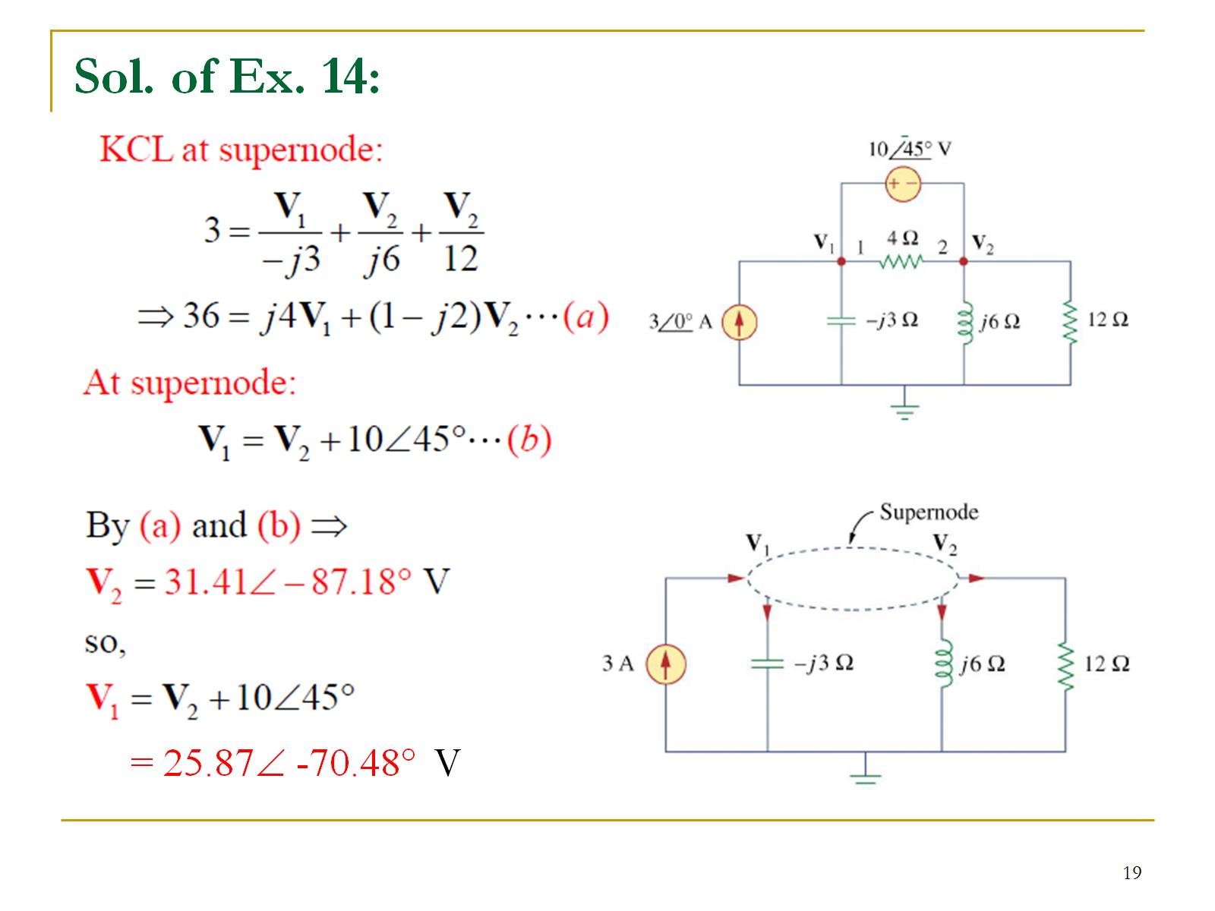
Sol. of Ex. 14:

Slide 20
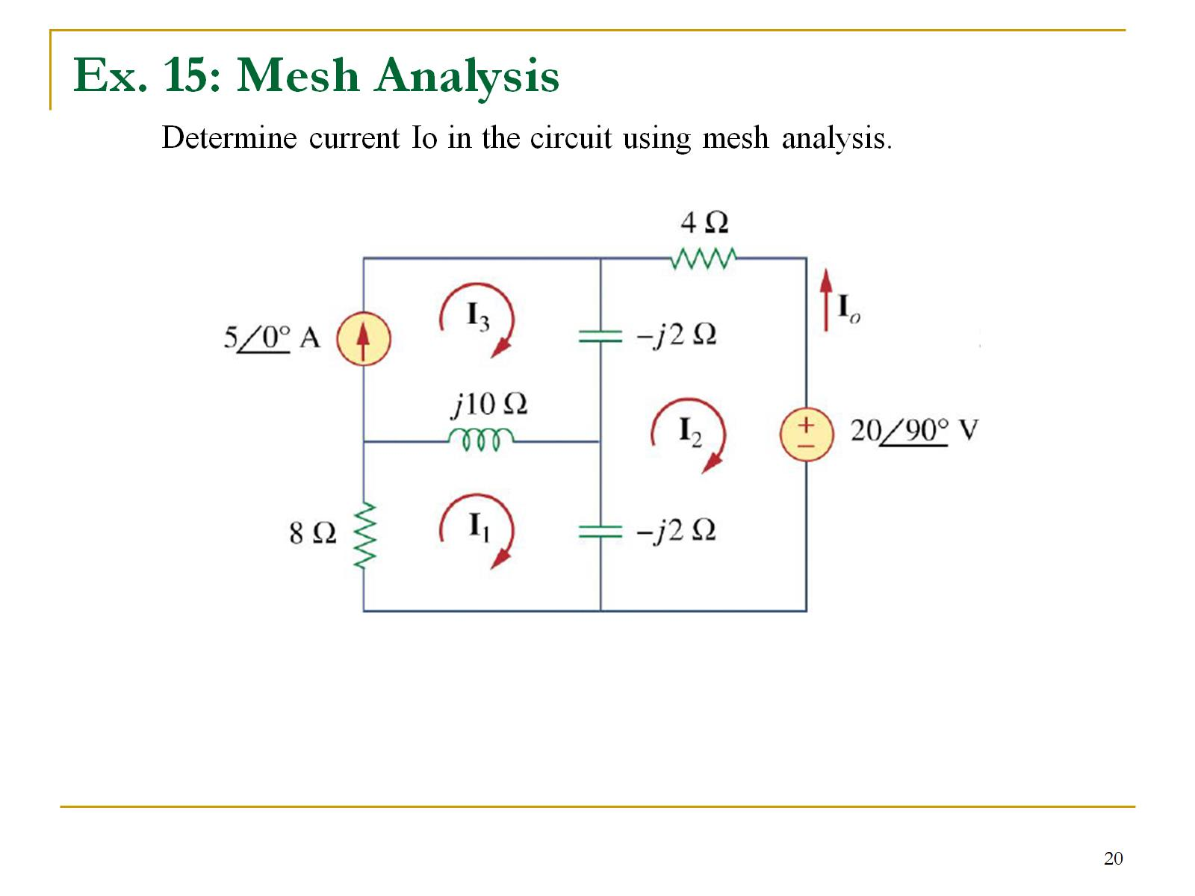
Ex. 15: Mesh Analysis

Slide 21
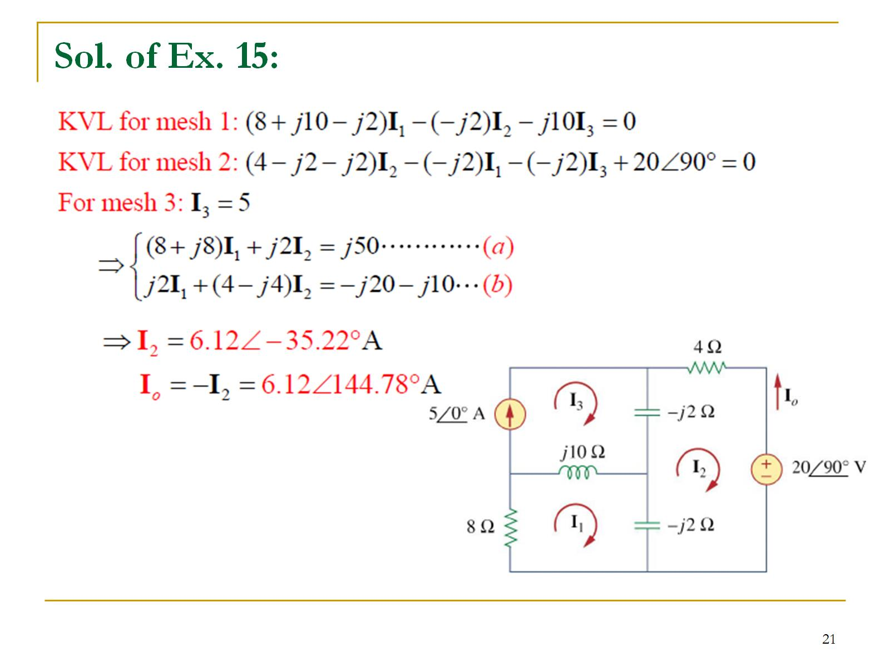
Sol. of Ex. 15:

Slide 22
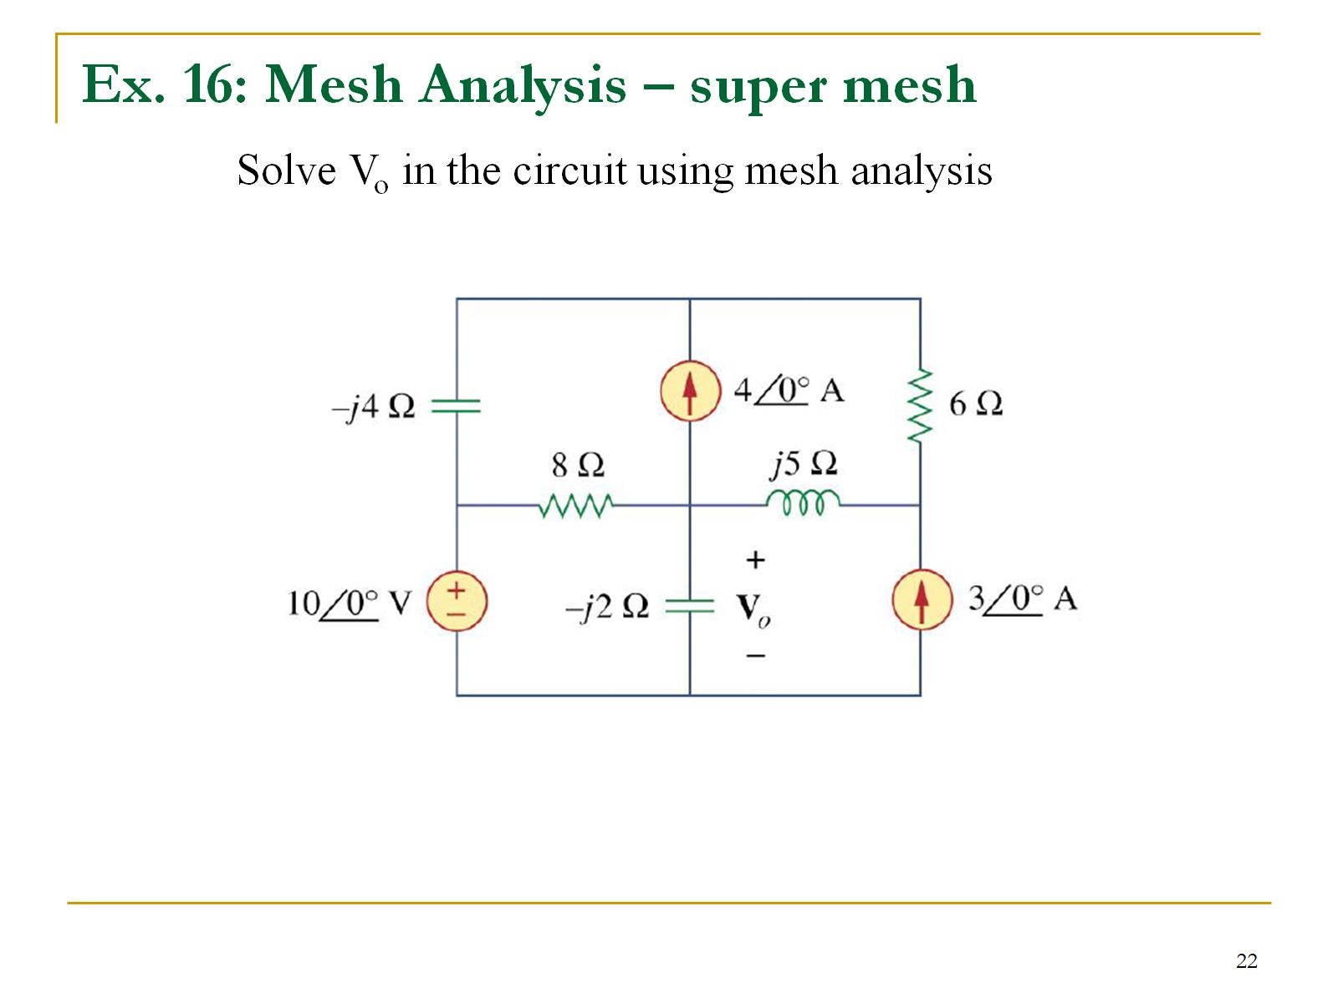
Ex. 16: Mesh Analysis – super mesh

Slide 23
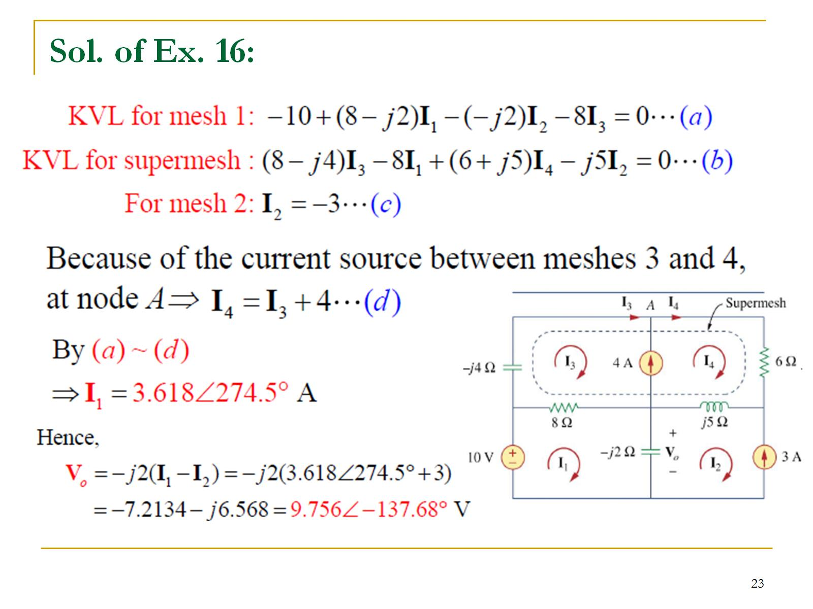
Sol. of Ex. 16:

Slide 24
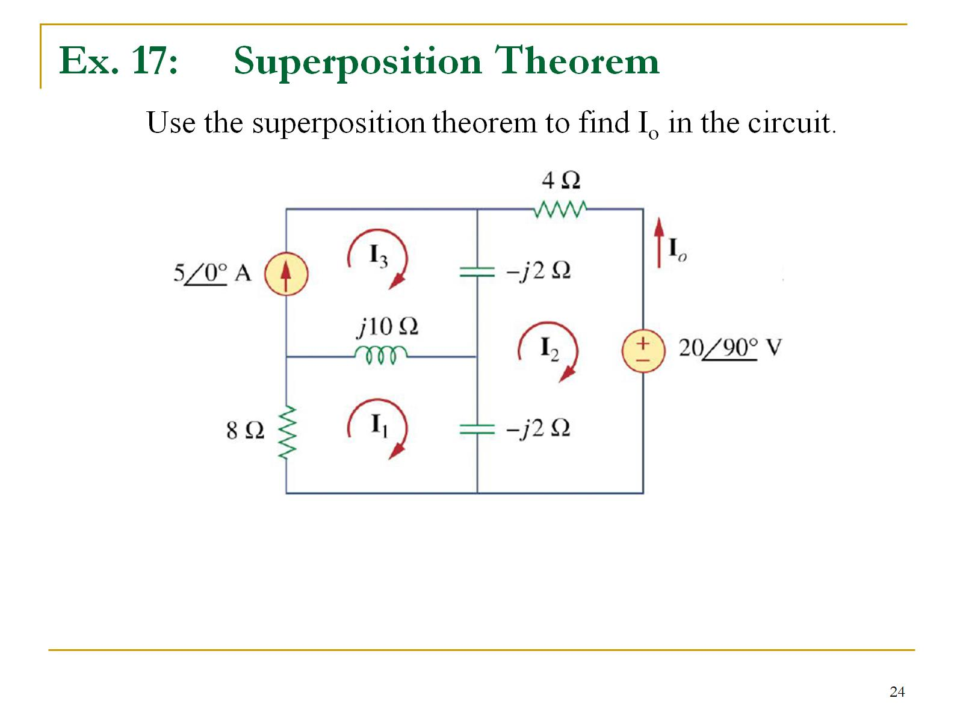
Ex. 17: Superposition Theorem

Slide 25
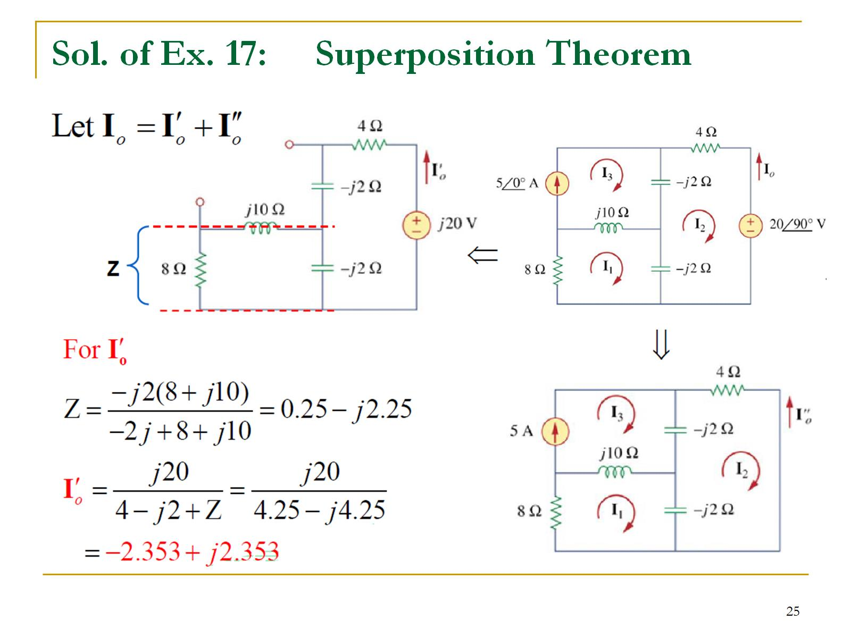
Sol. of Ex. 17: Superposition Theorem

Slide 26
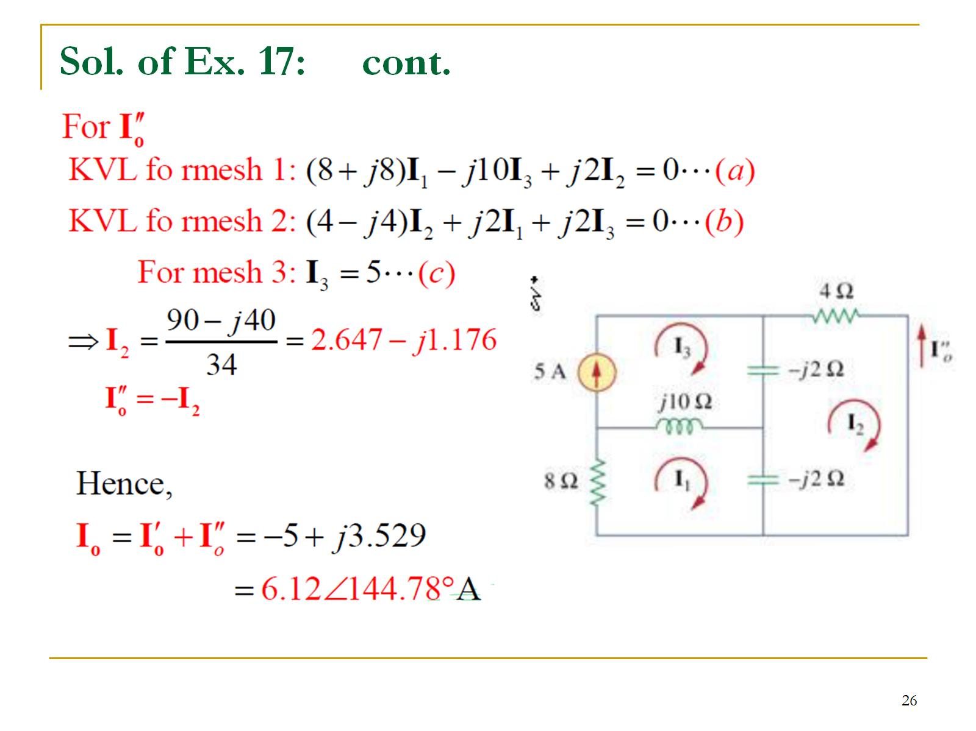
Sol. of Ex. 17: cont.

Slide 27
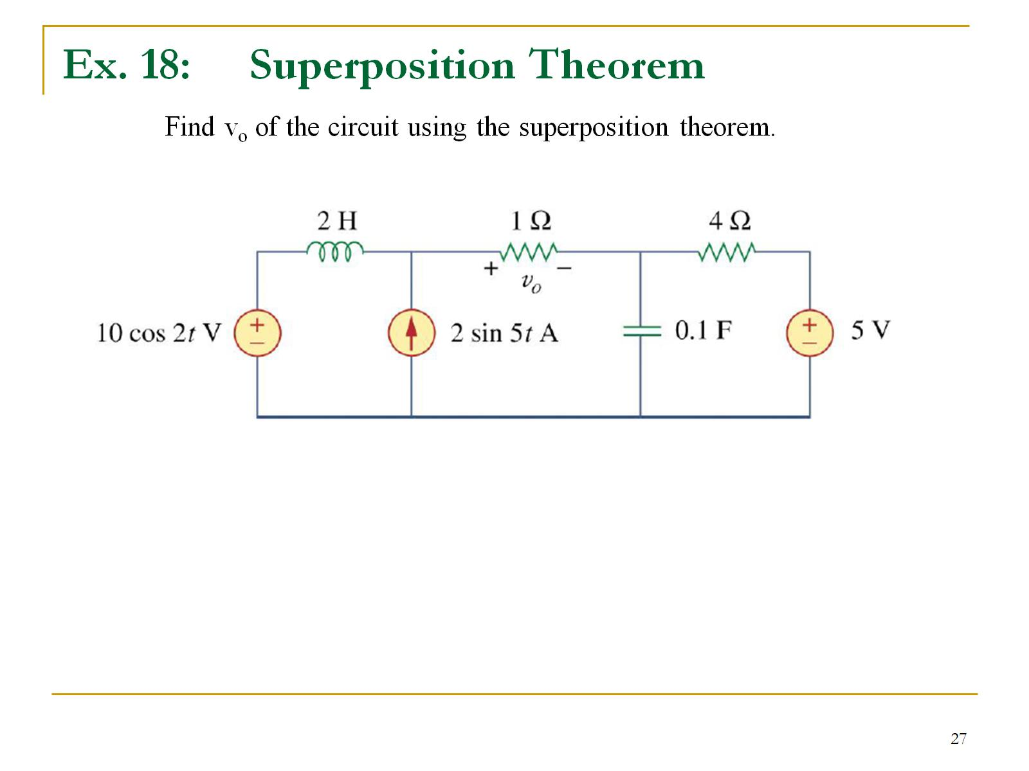
Ex. 18: Superposition Theorem

Slide 28
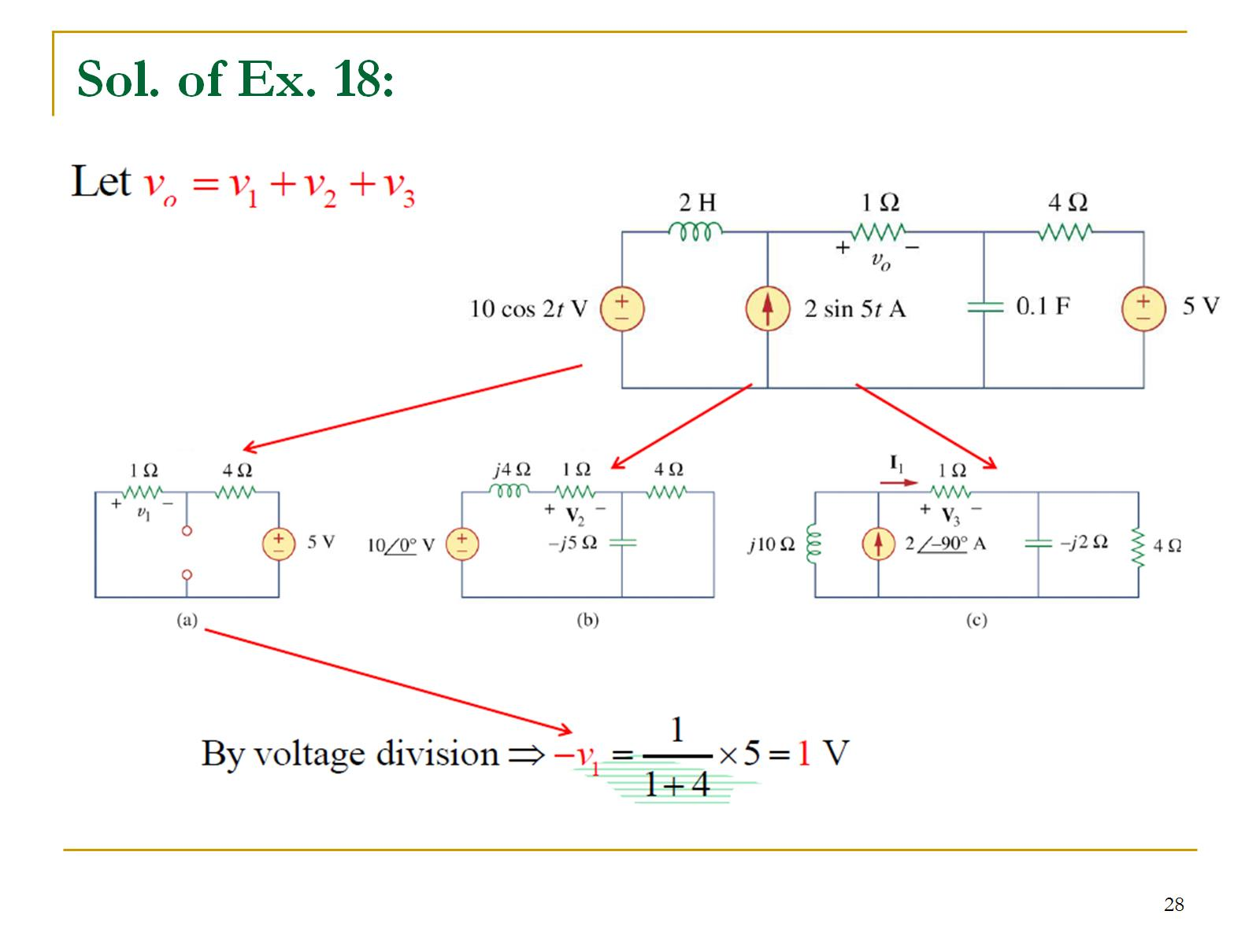
Sol. of Ex. 18:

Slide 29
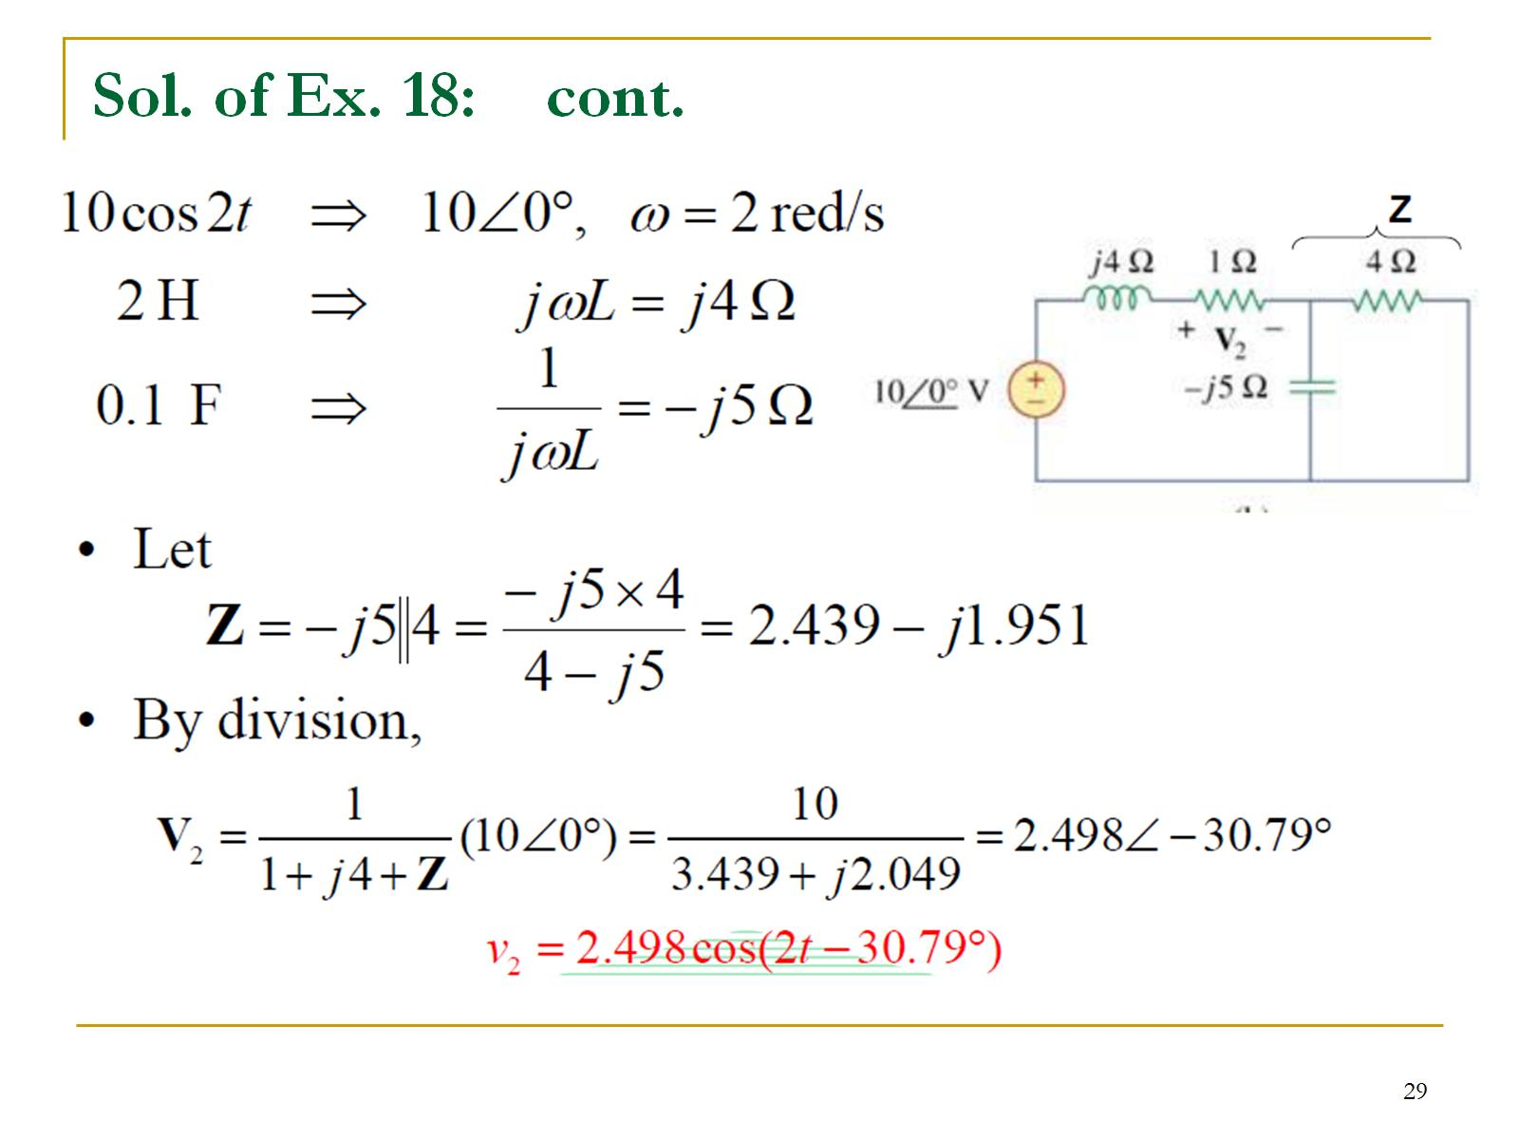
Sol. of Ex. 18: cont.

Slide 30
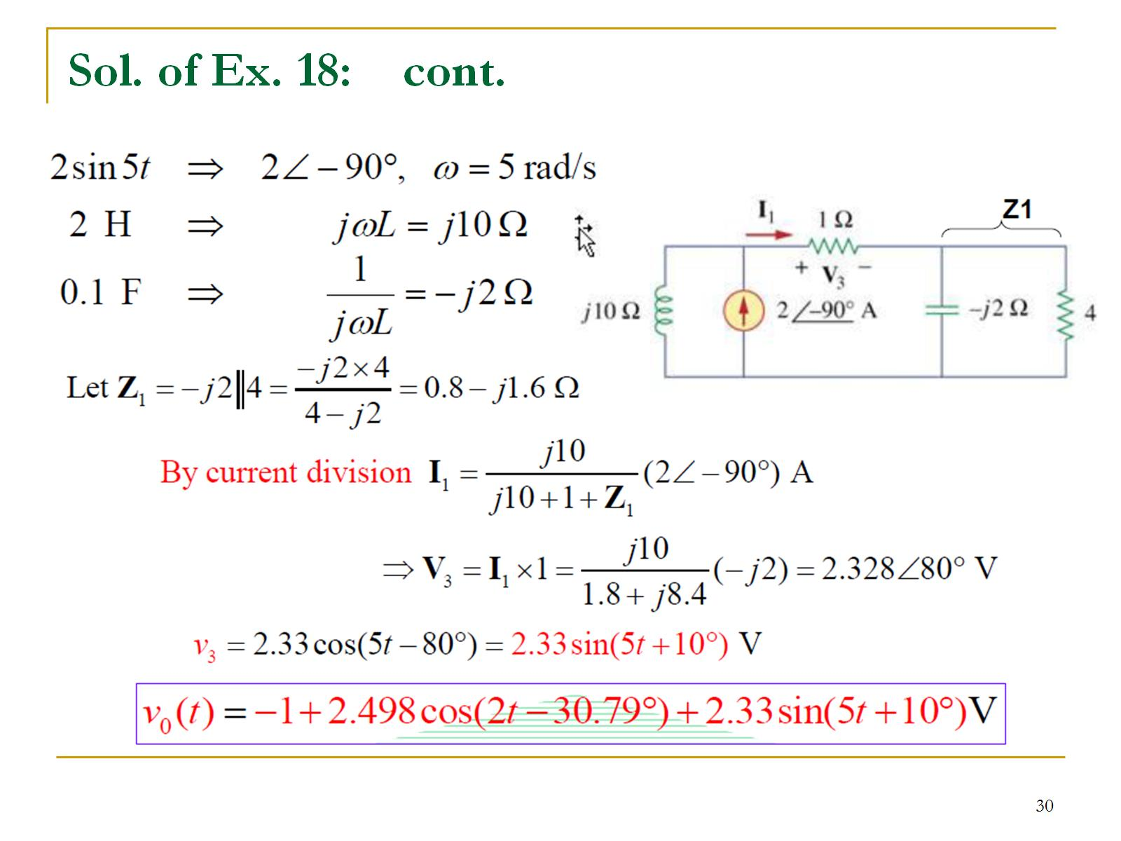
Sol. of Ex. 18: cont.

Slide 31
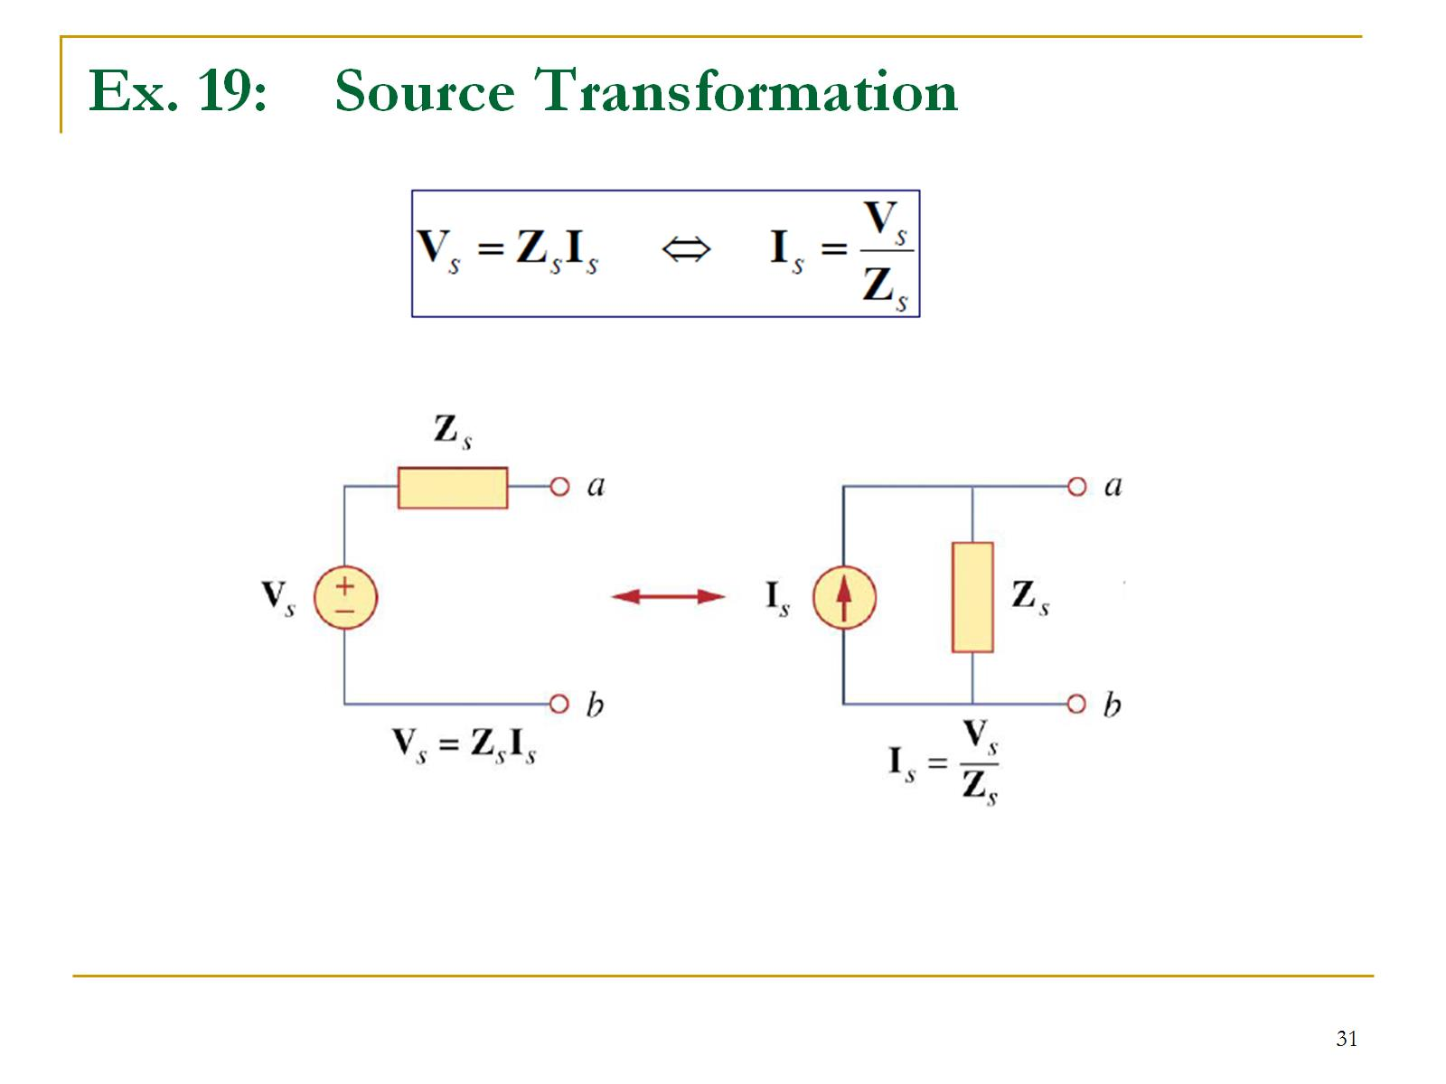
Ex. 19: Source Transformation

Slide 32
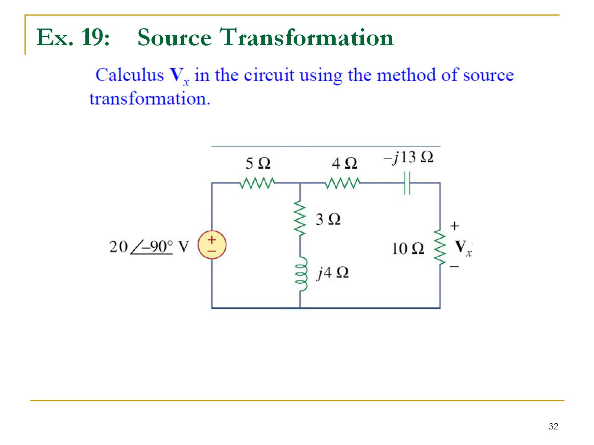
Ex. 19: Source Transformation

Slide 33
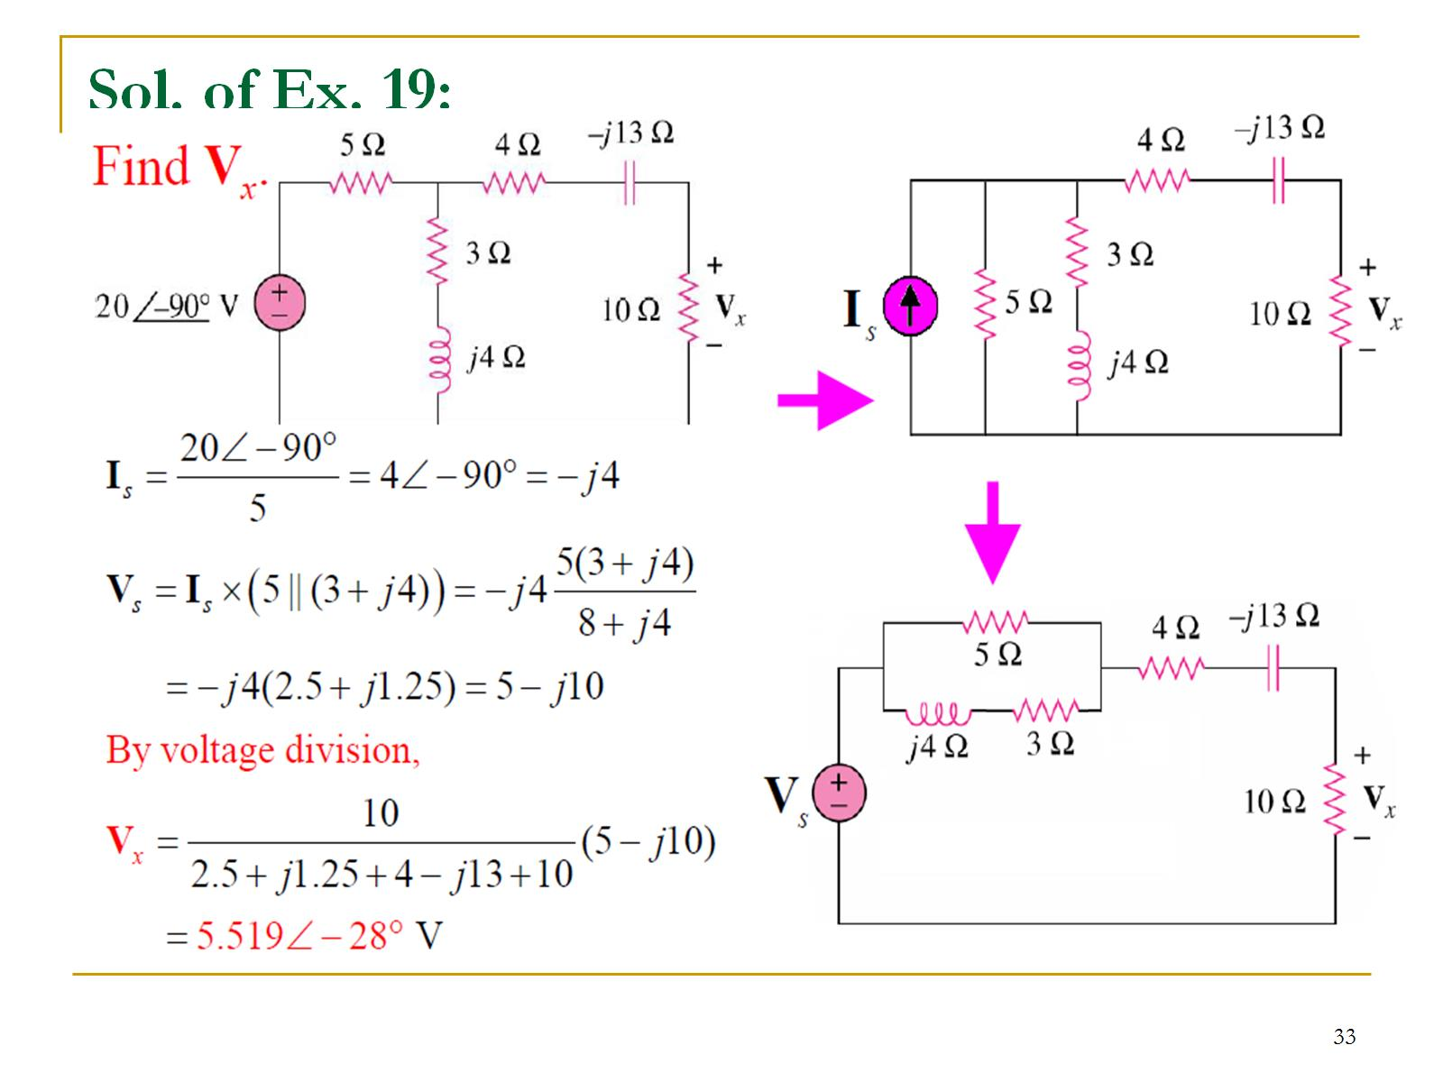
Sol. of Ex. 19:

Slide 34
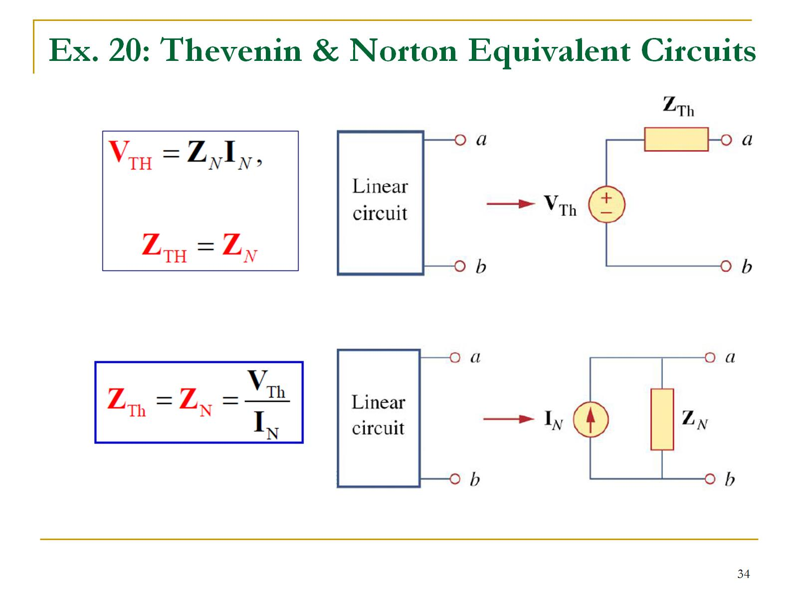
Ex. 20: Thevenin & Norton Equivalent Circuits

Slide 35
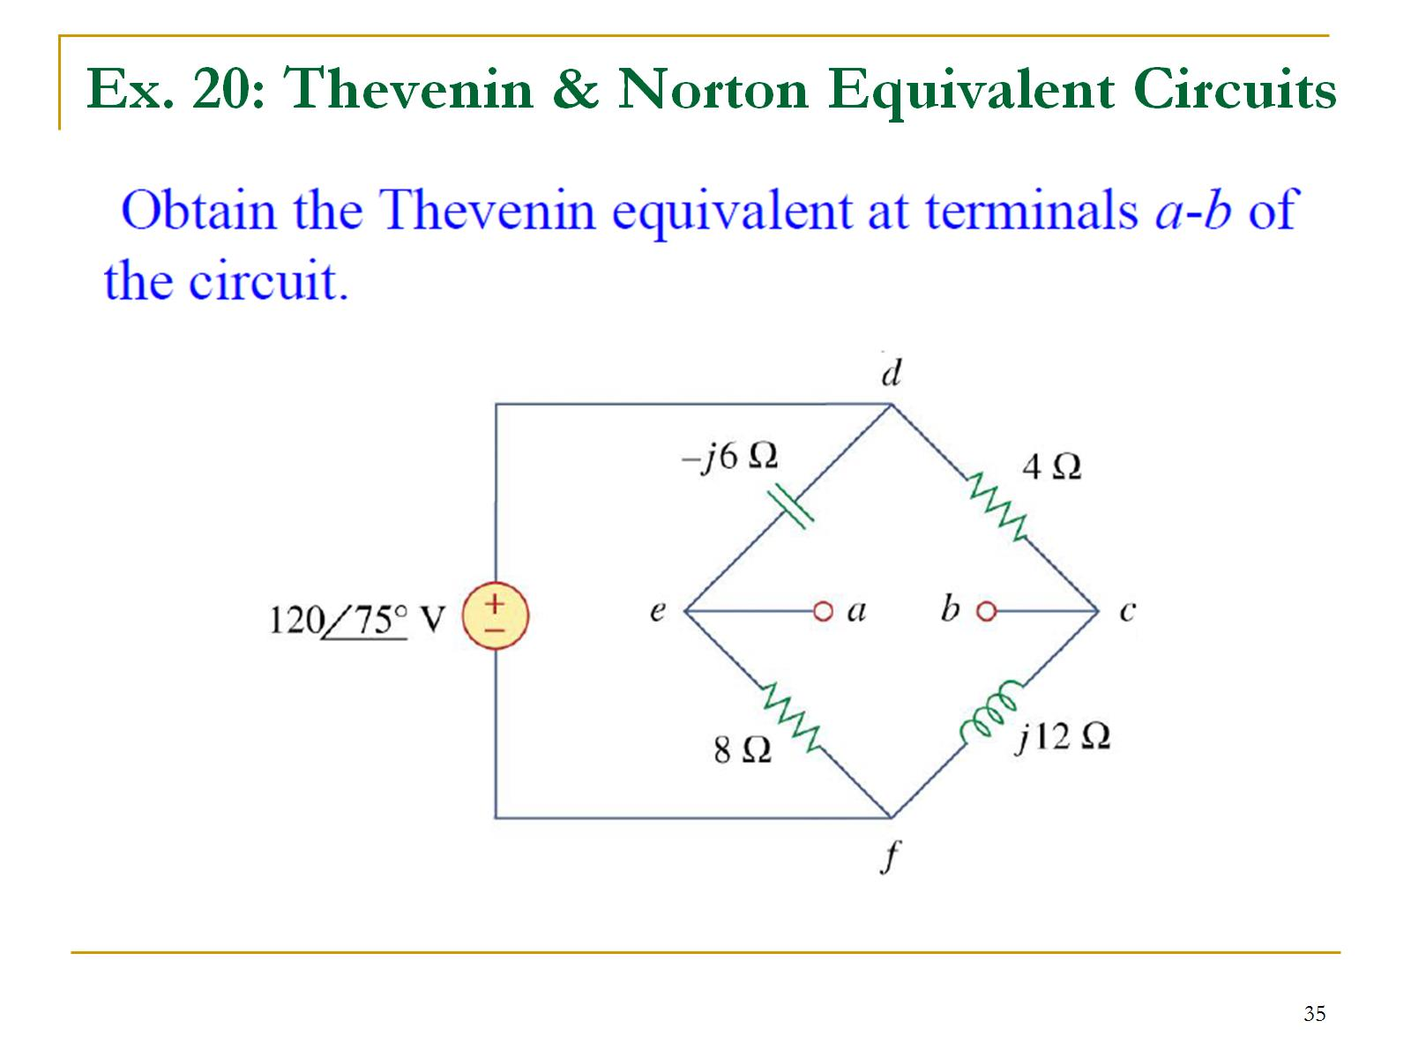
Ex. 20: Thevenin & Norton Equivalent Circuits

Slide 36
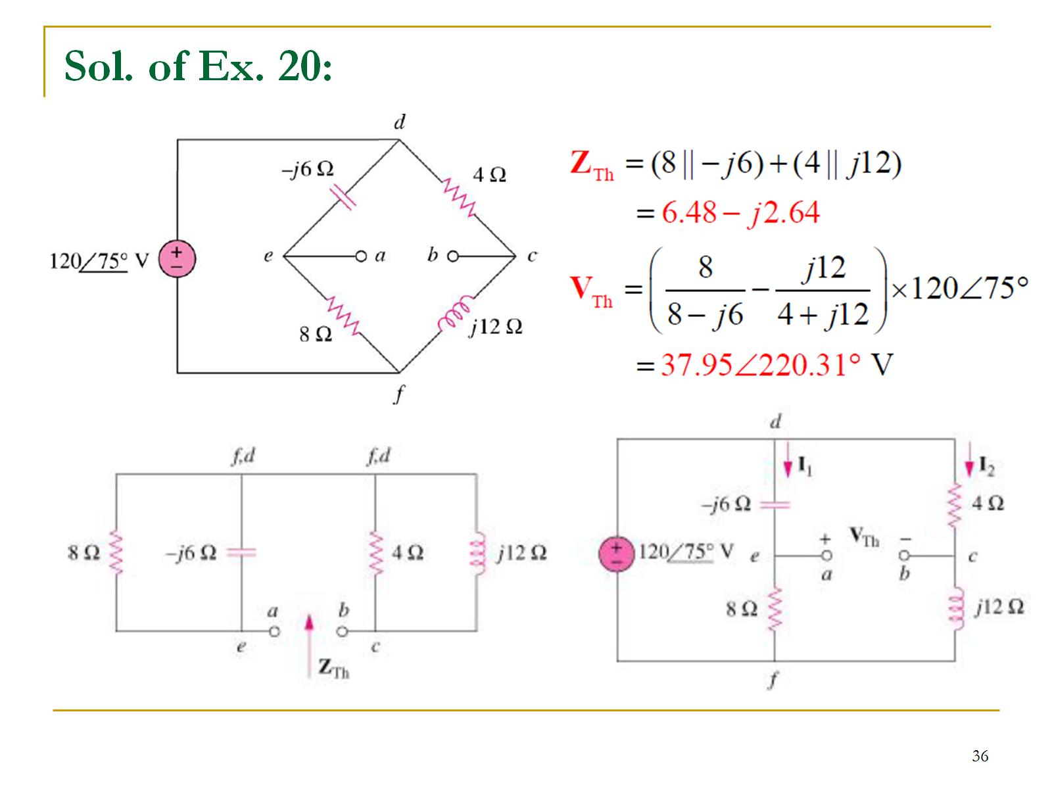
Sol. of Ex. 20:

Slide 37
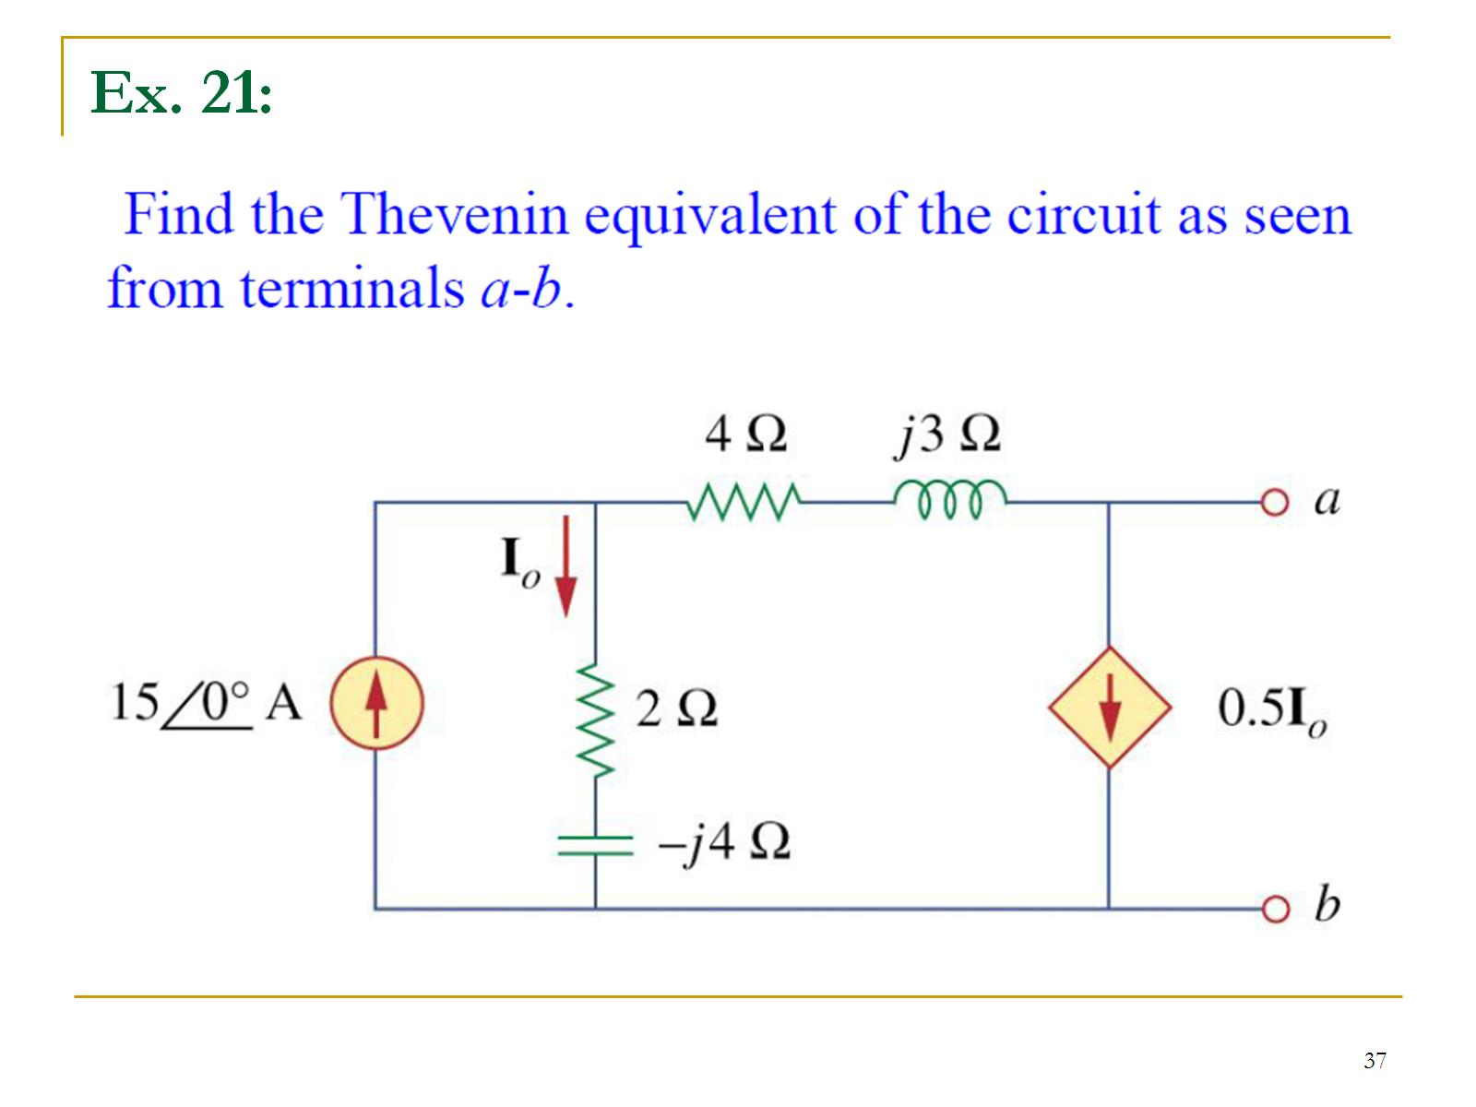
Ex. 21:

Slide 38
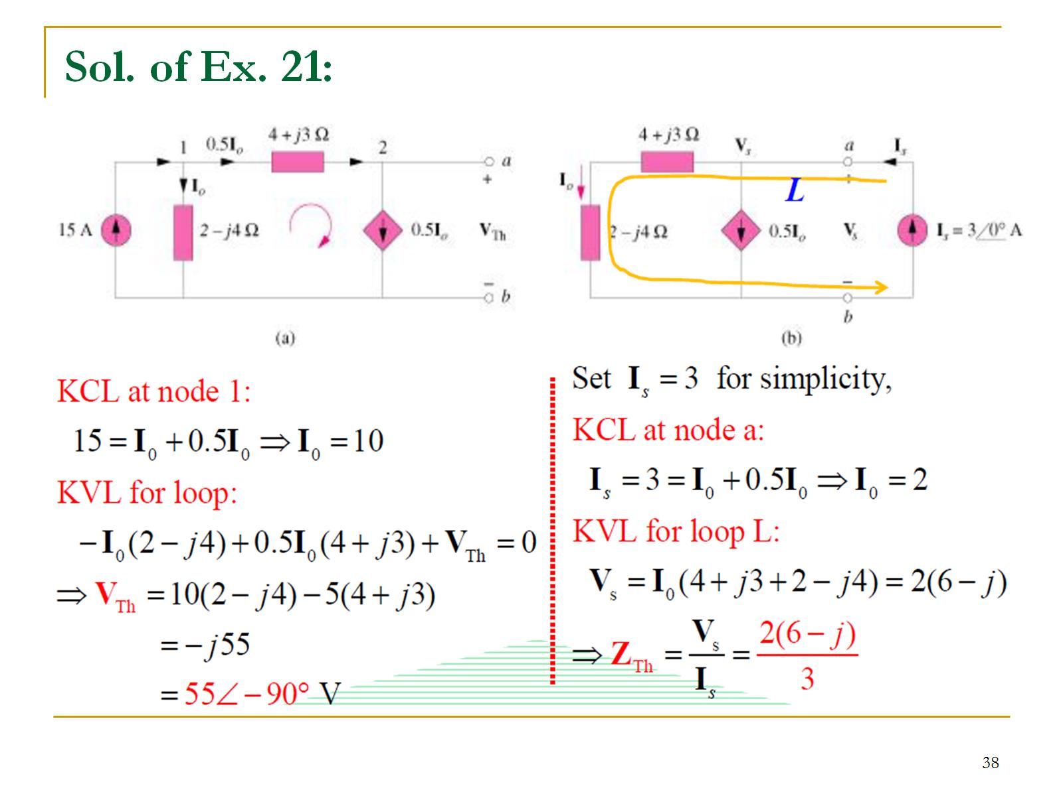
Sol. of Ex. 21:

Slide 39
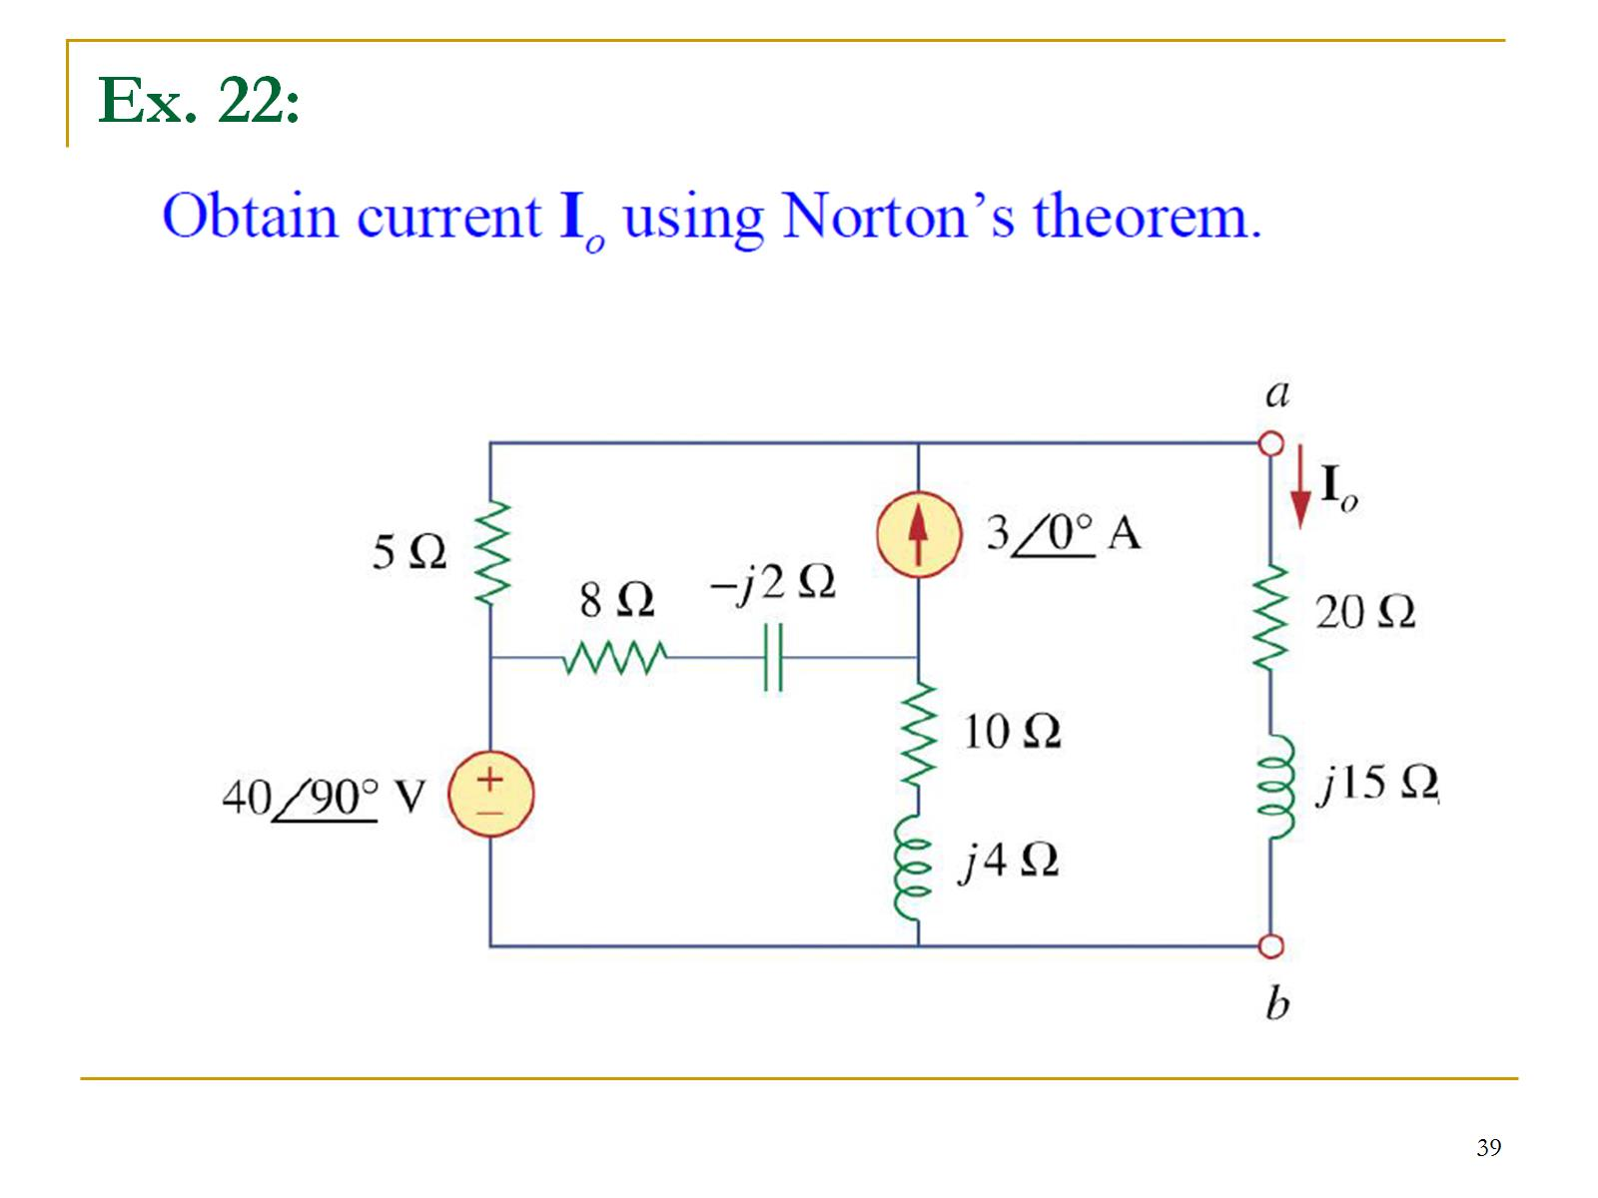
Ex. 22:

Slide 40
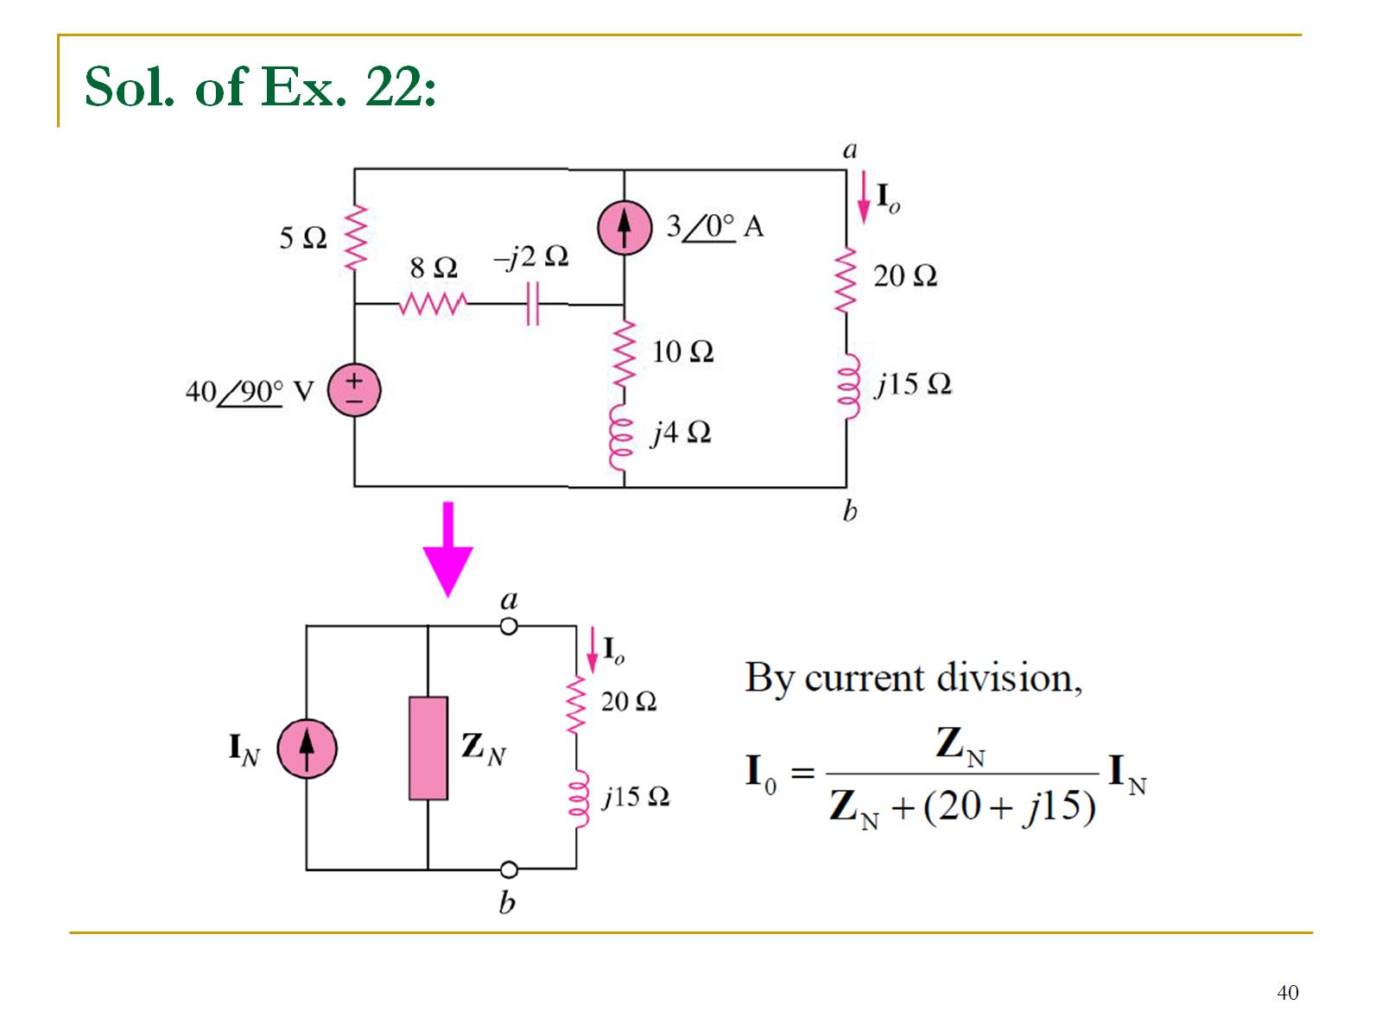
Sol. of Ex. 22:

Slide 41
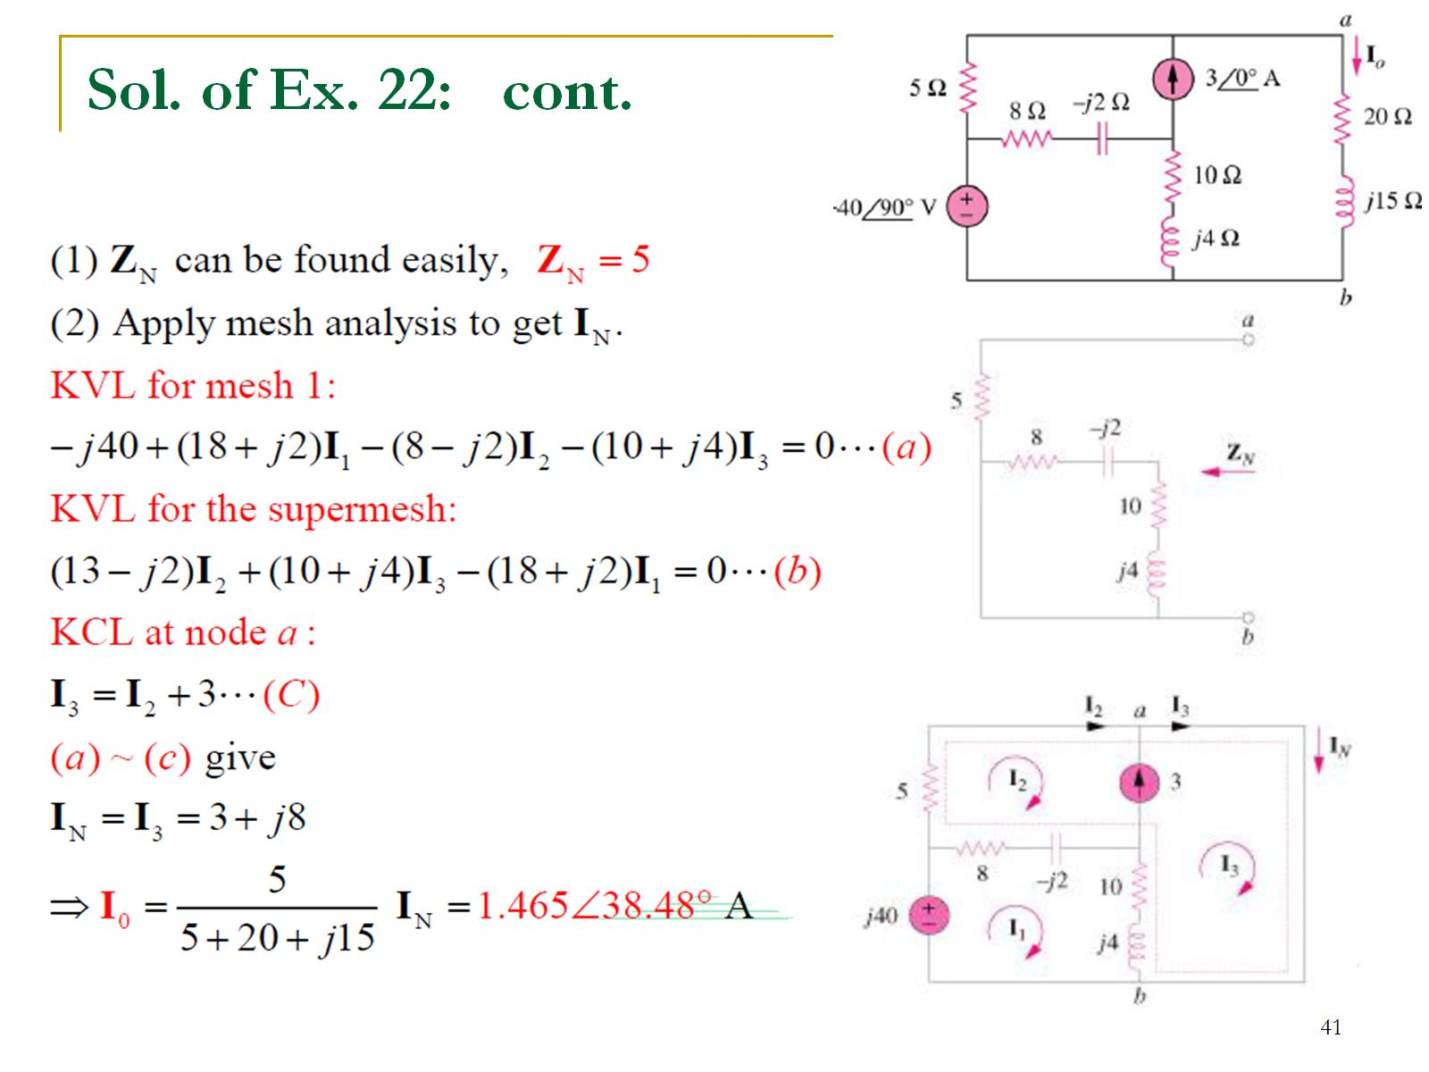
Sol. of Ex. 22: cont.

Slide 42
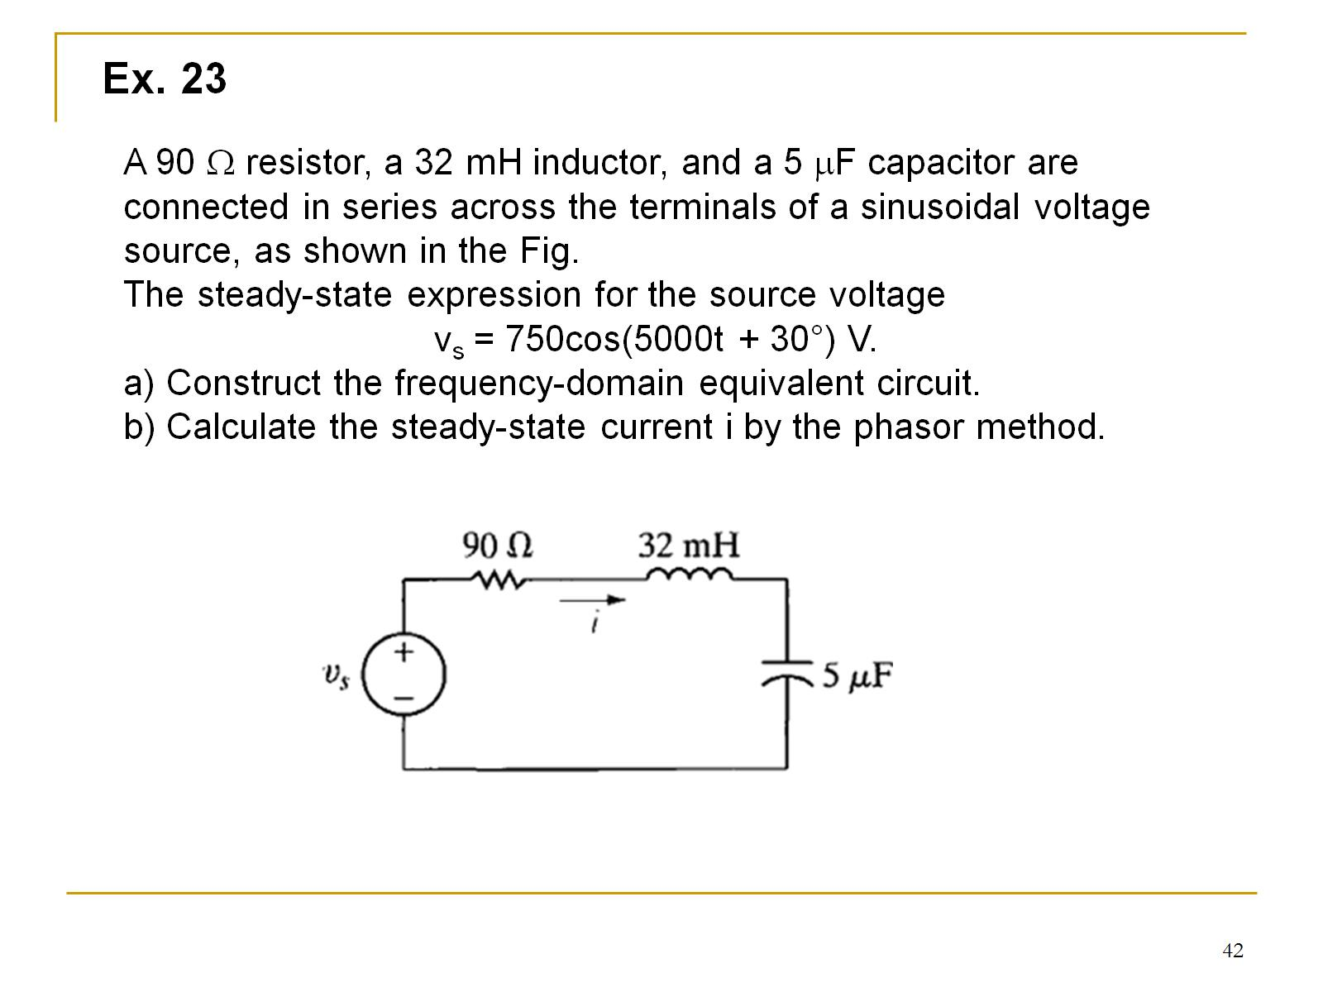

Slide 43
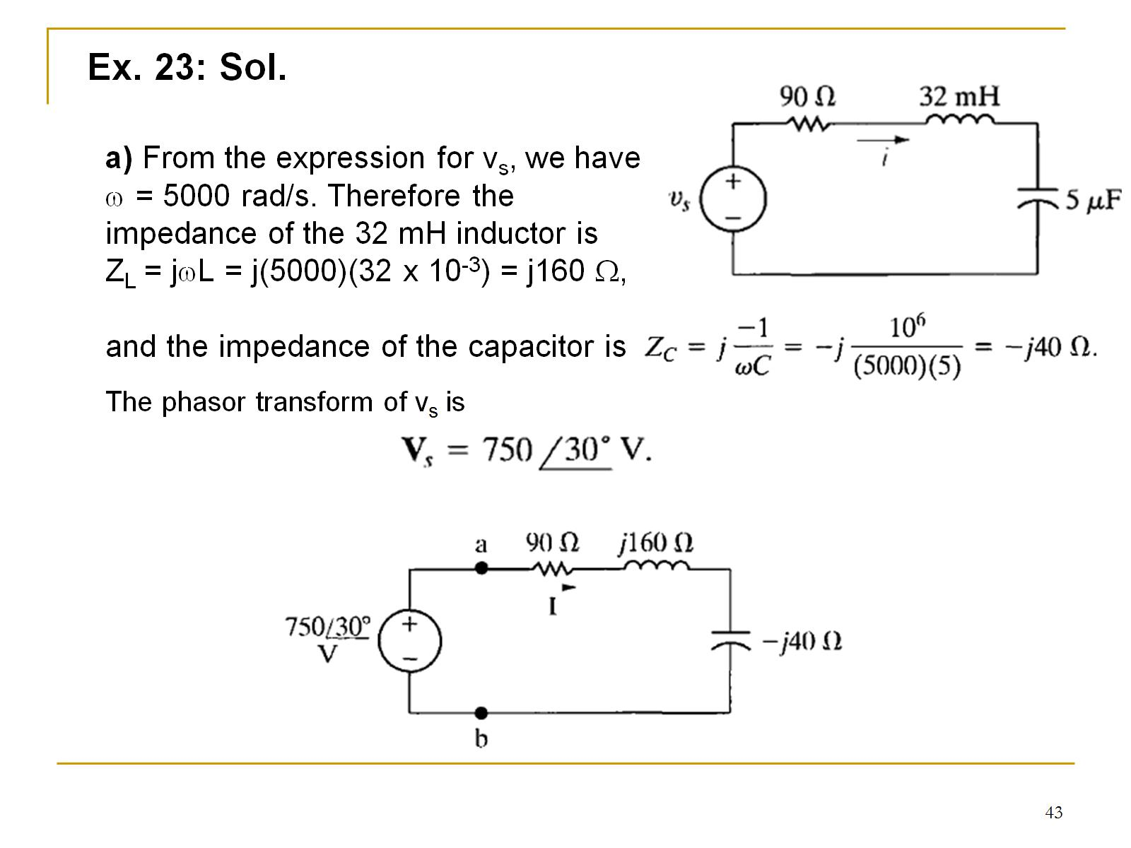

Slide 44
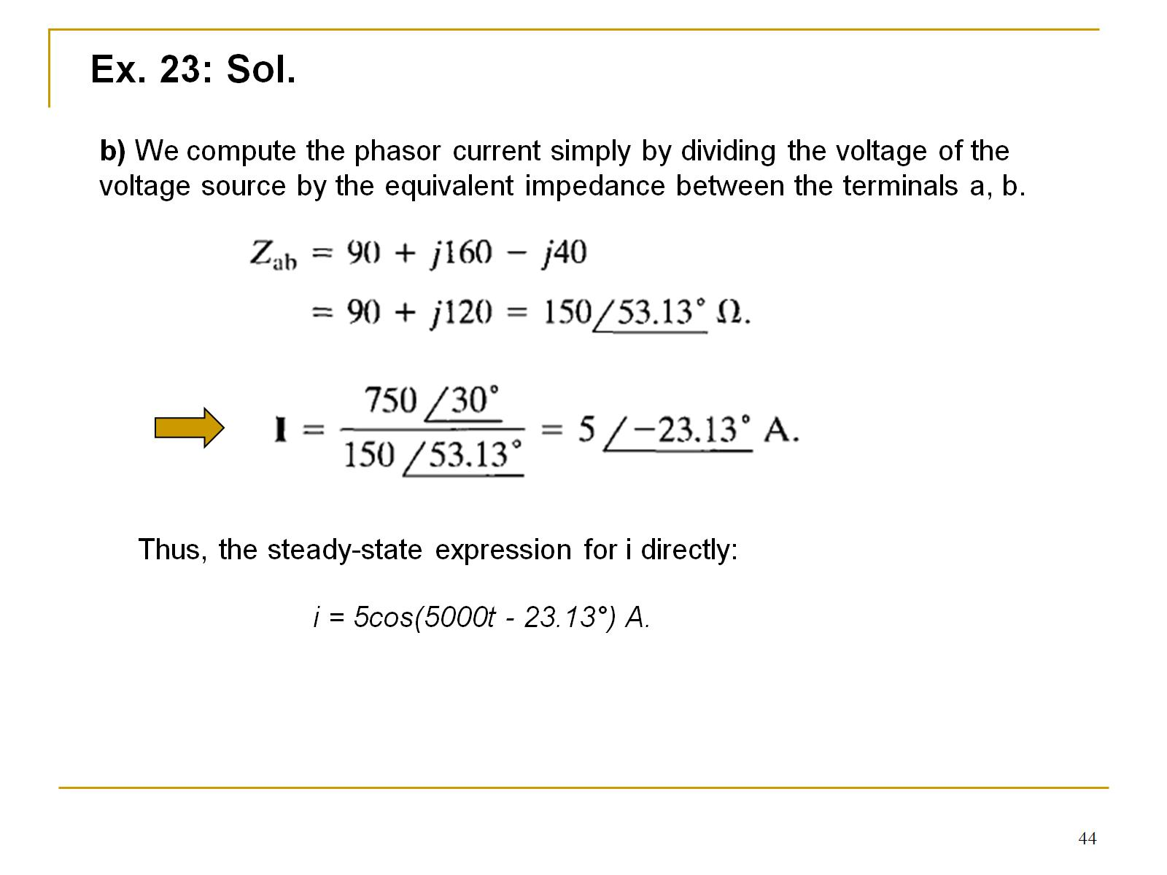

Slide 45
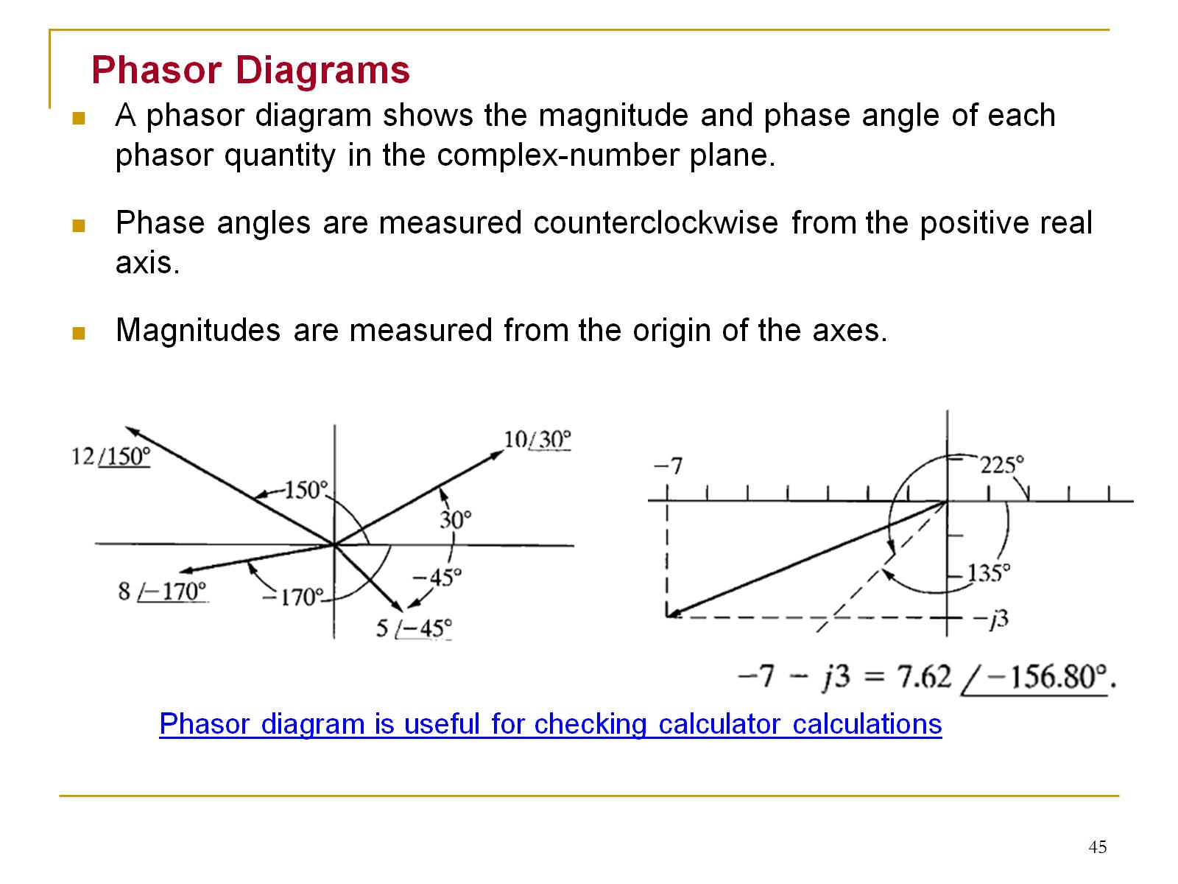

Slide 46
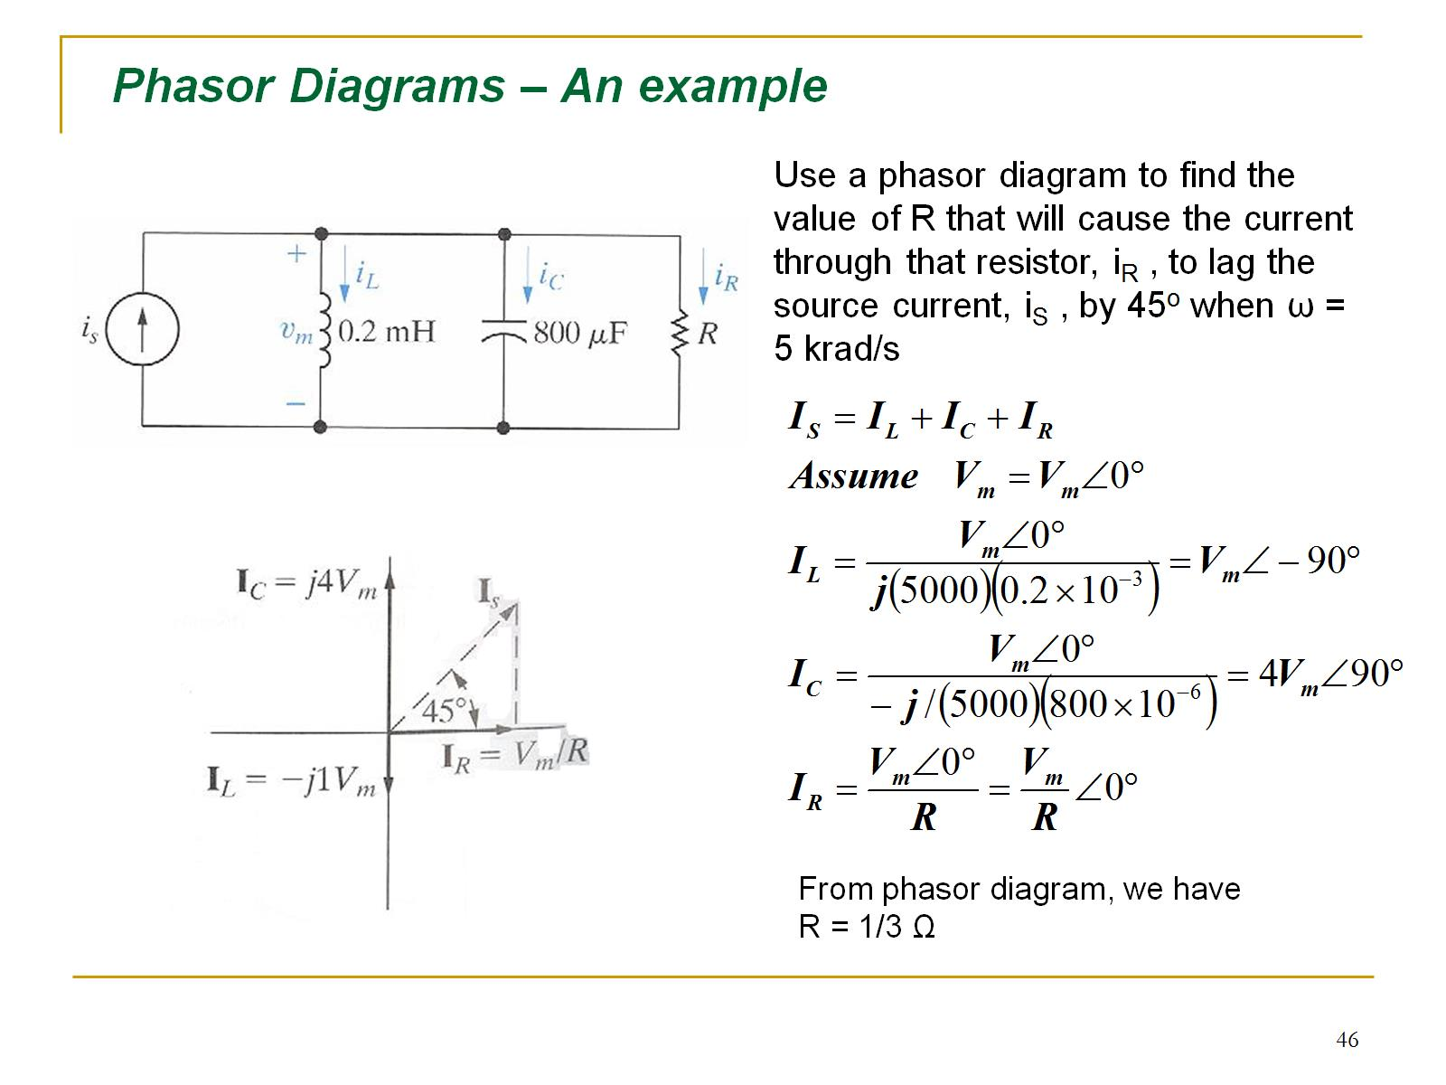

Slide 47
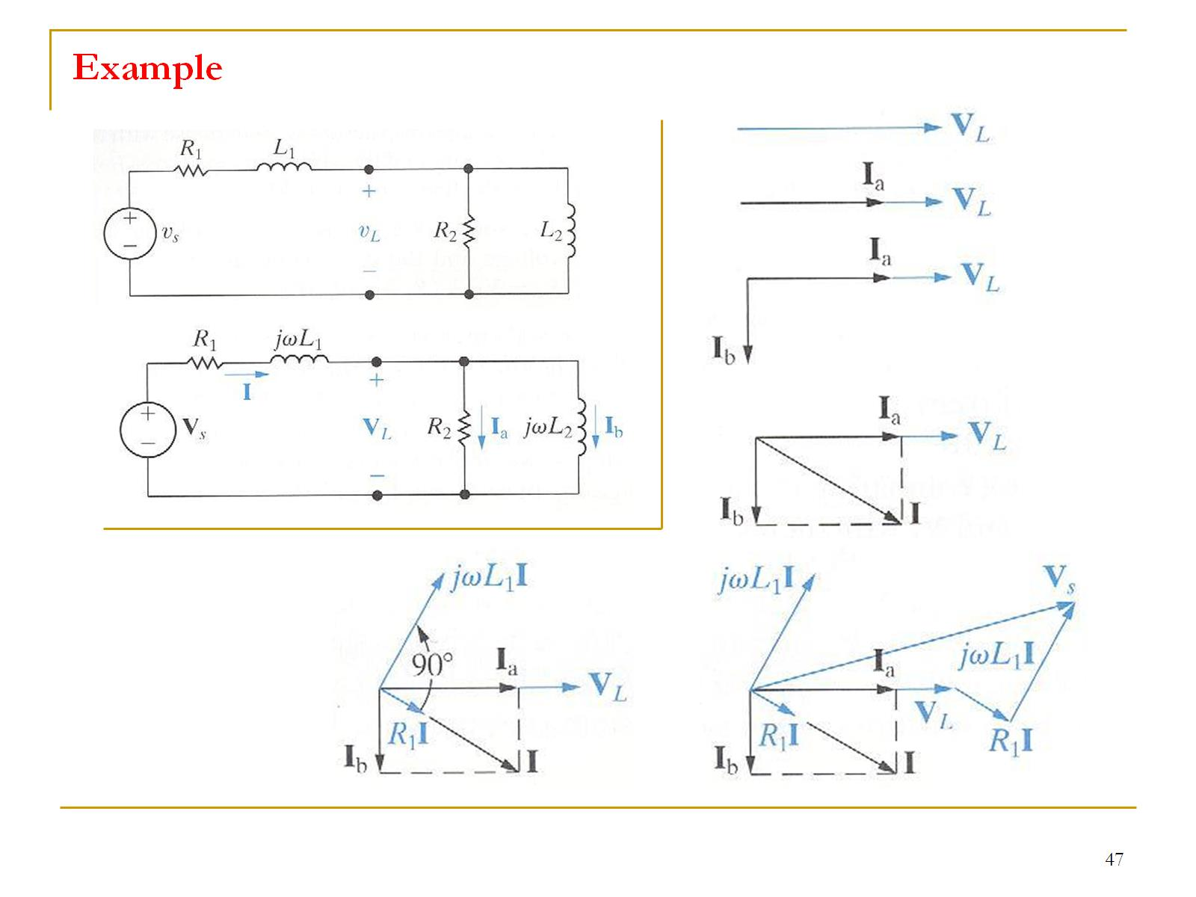
Example

